Slide 1

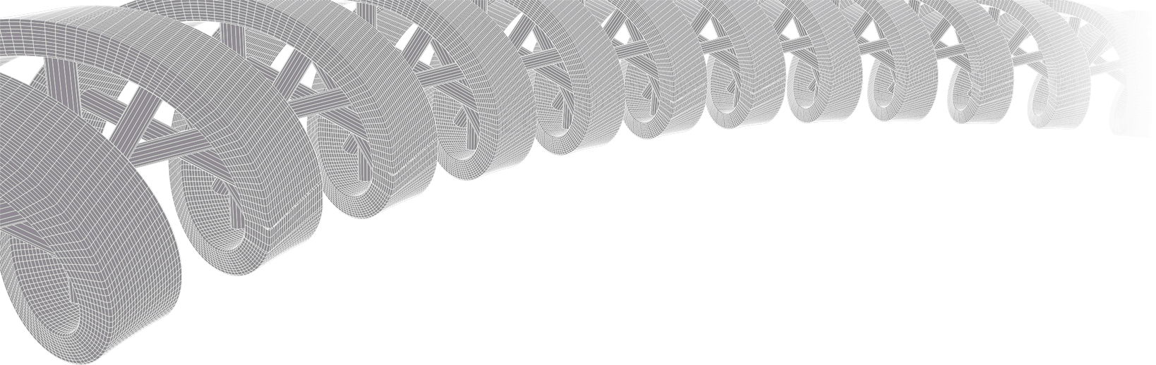
Genomic data visualization and interpretation
Malachi Griffith, Obi Griffith, Zachary Skidmore
Evomics, Workshop on Genomics
Jan 11, 2019
Český Krumlov, Czech Republic

Slide 2
Make this lecture way shorter
Focus on genomics visualizations …
Fundamental concepts of ggplot?
Principles of good visualization that are interactive with the class…

Slide 3
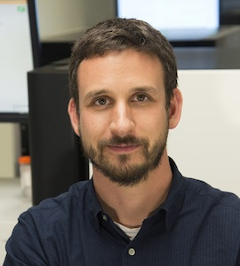
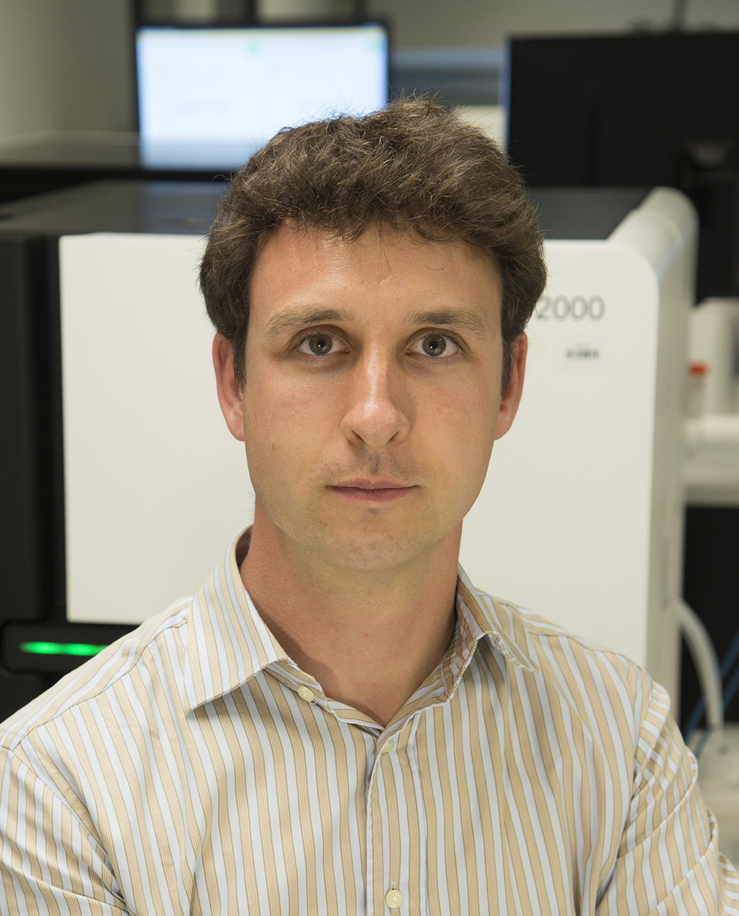
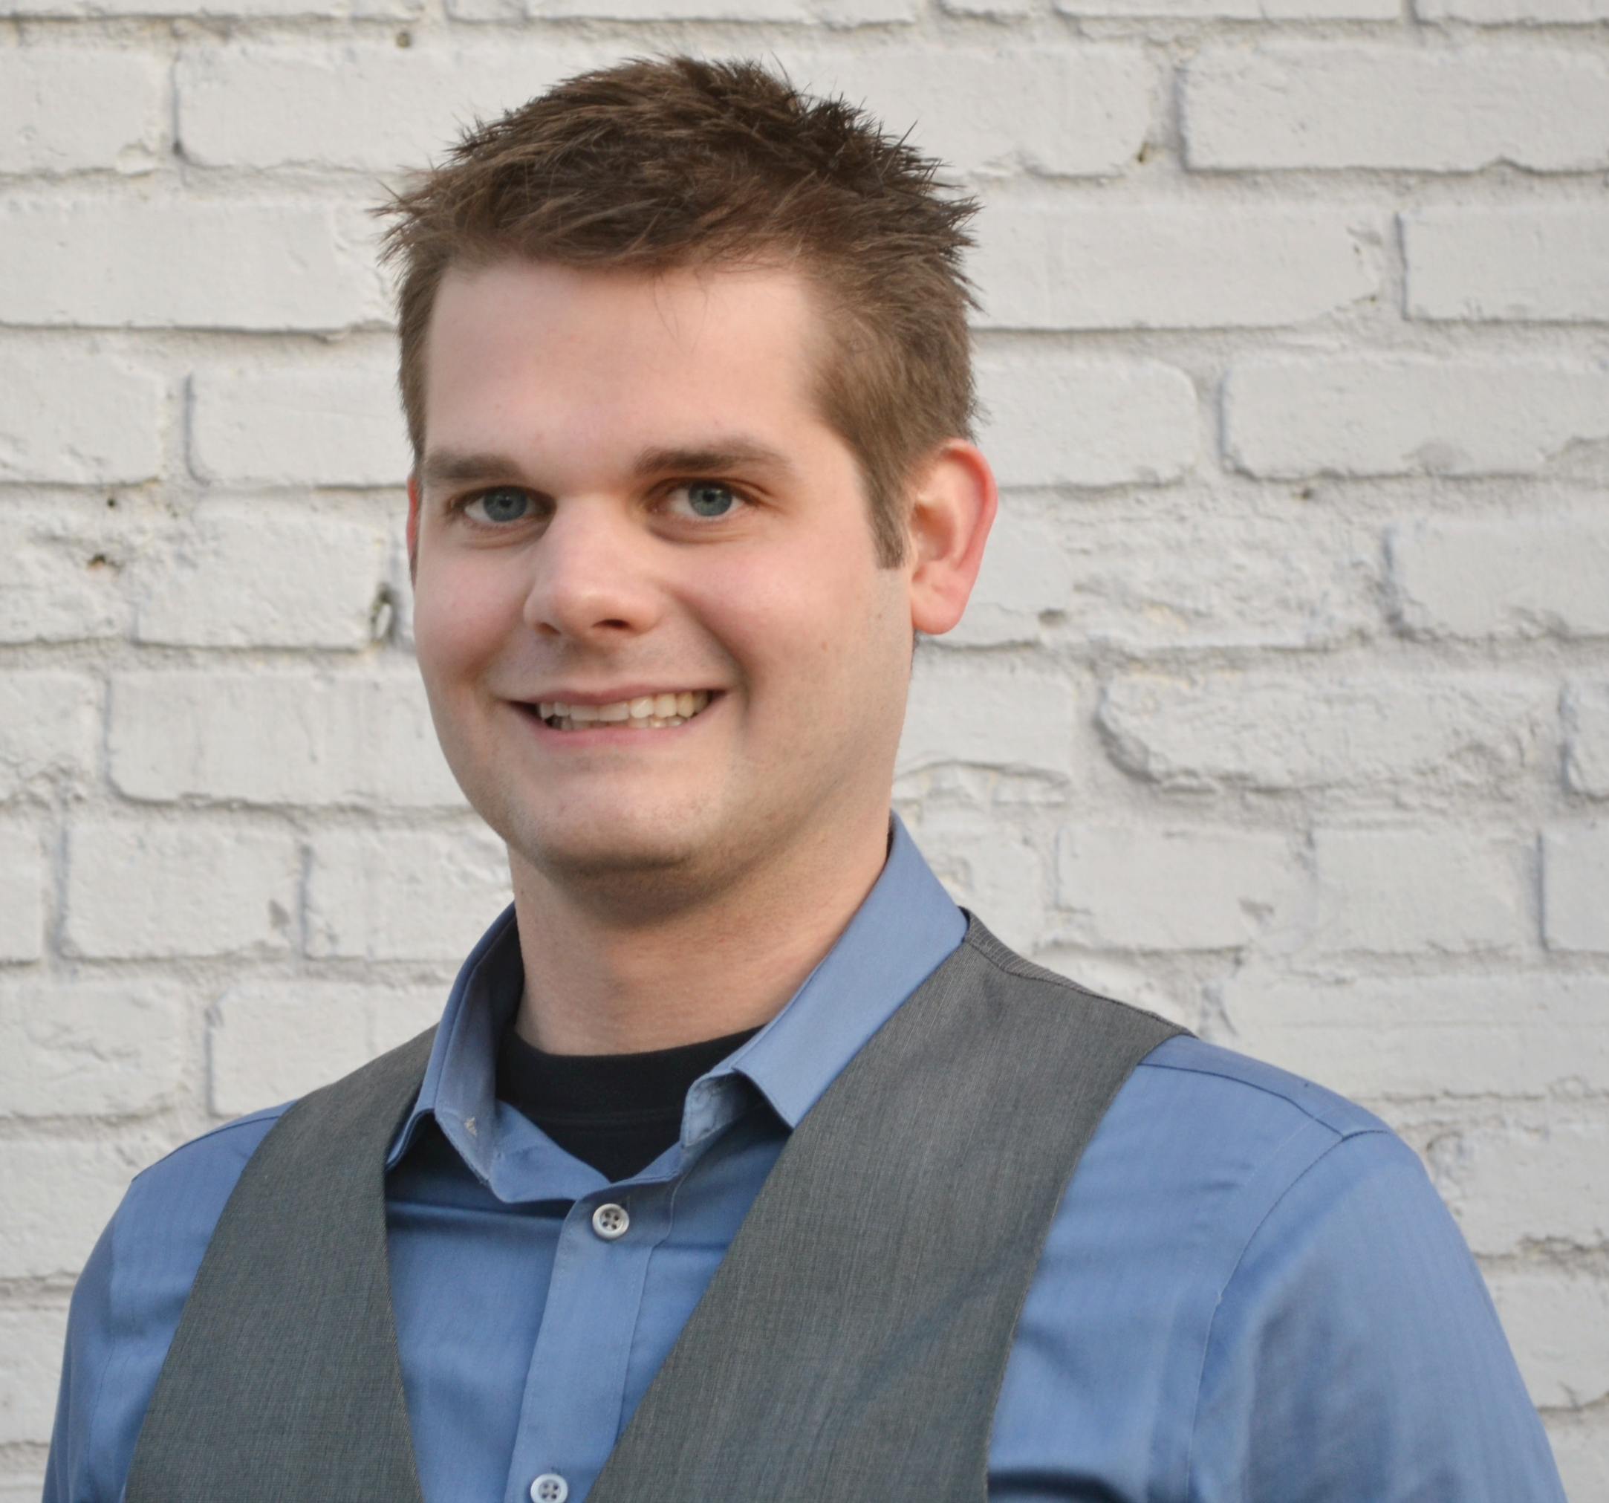
Introductions to course instructors
Malachi Griffith, PhD
Assistant Professor of Medicine Assistant Professor of Genetics
Assistant Director, MGI
Obi Griffith, PhD
Assistant Professor of Medicine Assistant Professor of Genetics
Assistant Director, MGI
Zachary Skidmore, MSc
Staff Scientist, MGI
GenVisR creator
McDonnell Genome Institute, Washington University School of Medicine

Slide 4
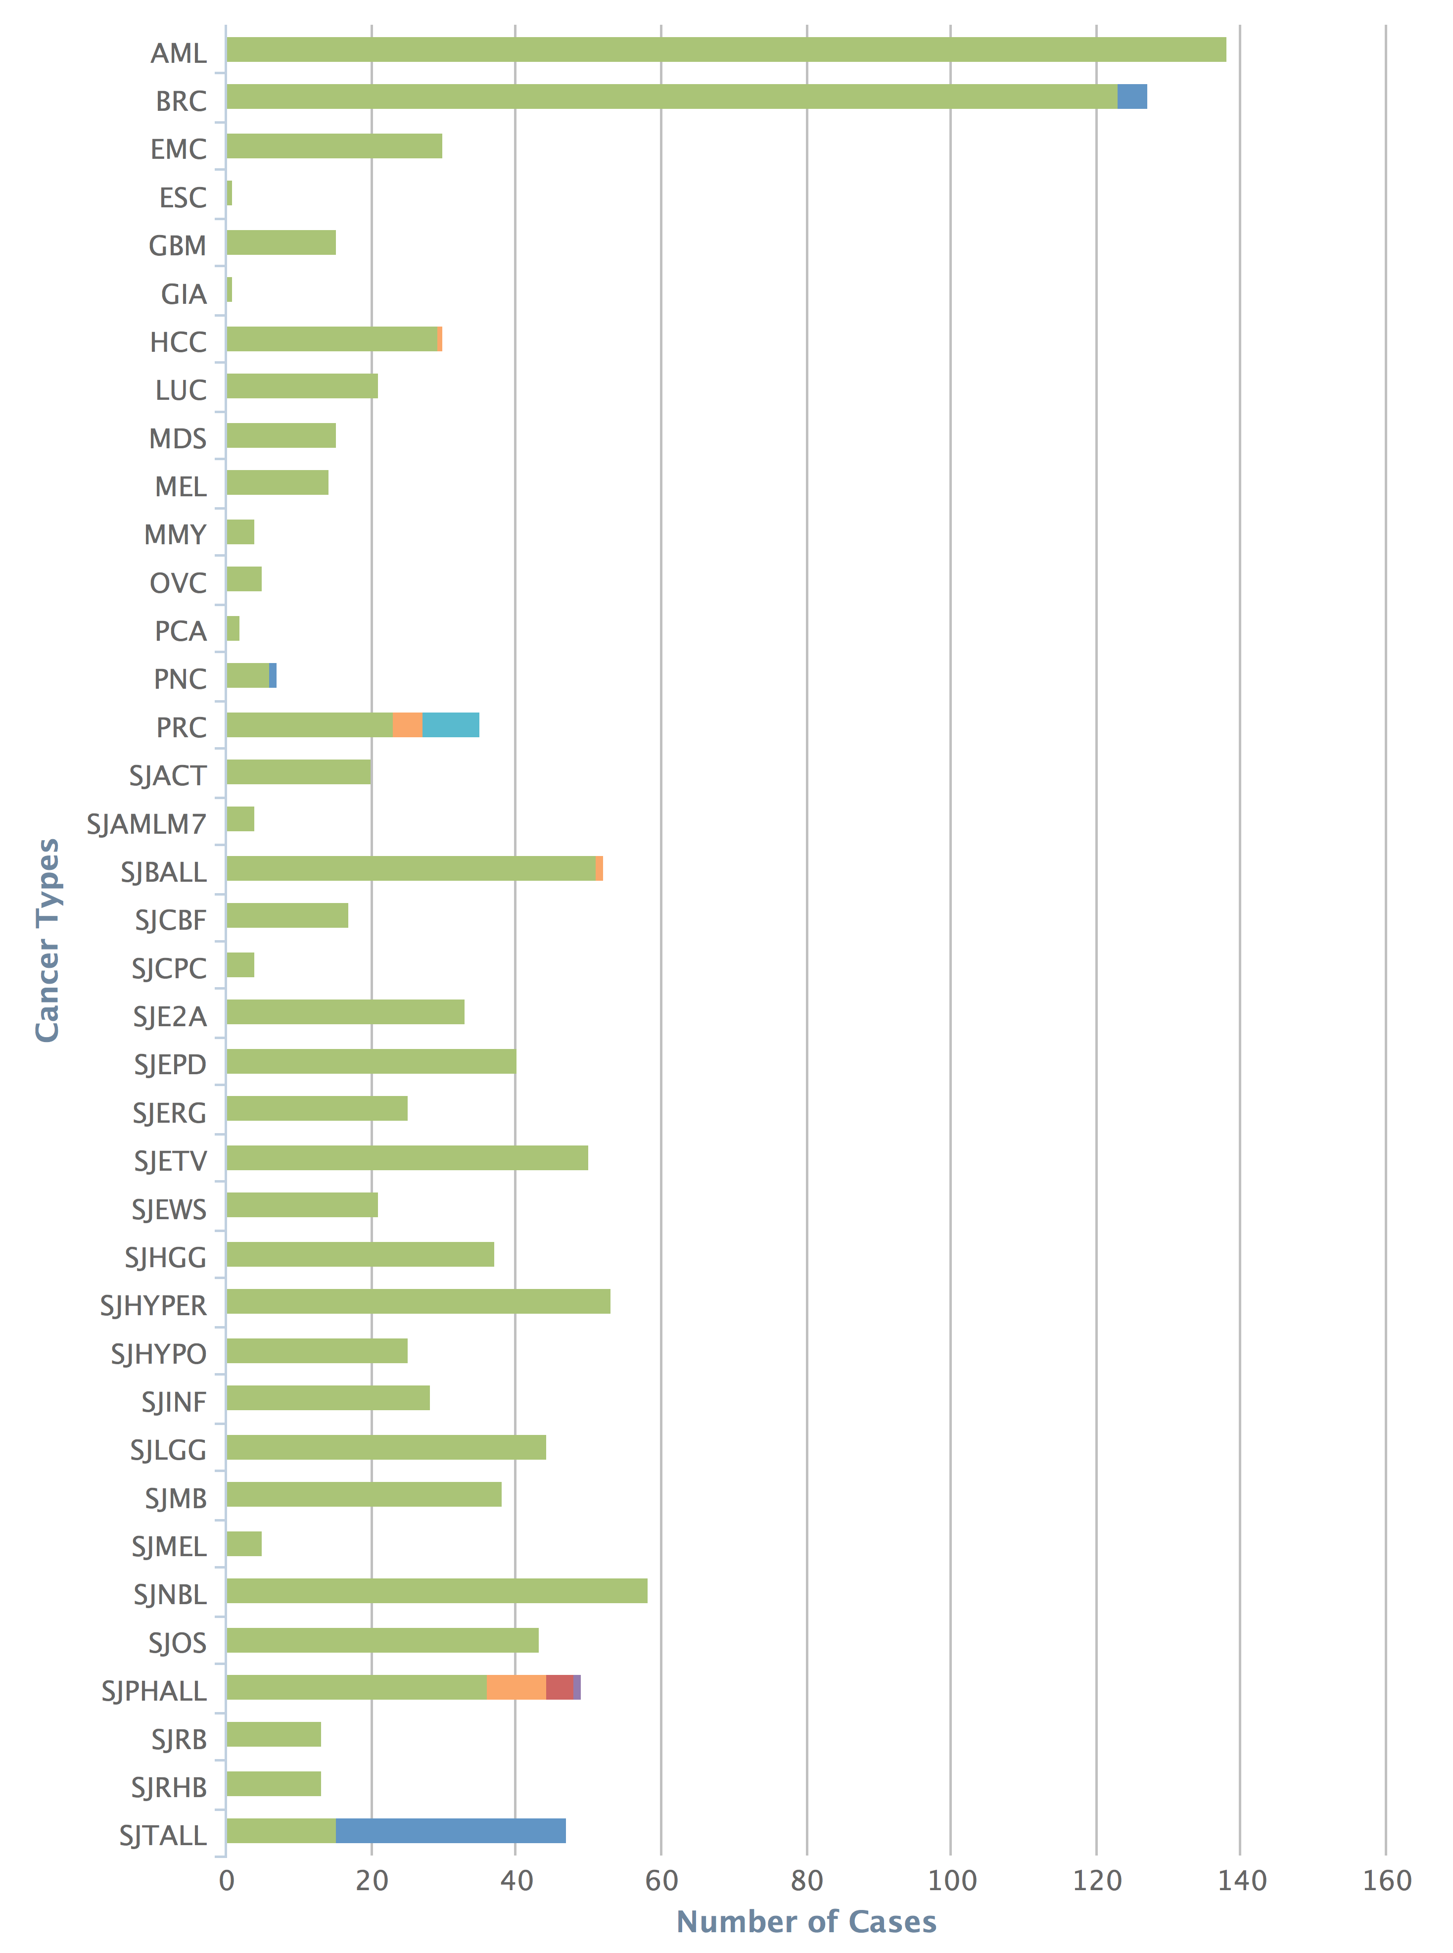
The McDonnell Genome Institute has pursued the field of genomics since inception: >1000 whole genomes, >5000 exomes, >1000 transcriptomes for dozens of tumor types
Human Genome Project
First to sequence and analyze a tumor whole genome sequence (Ley et al, 2008)
Major contributor to TCGA, PCGP, etc.
Most comprehensively sequenced single patient tumor ever published (Griffith et al, 2015)
Early proof-of-principle for cancer precision medicine (Griffith et al, 2016)
Analysis and tools for first personalized cancer vaccine design in humans (Carreno et al, 2015)
Many other widely used tools
Cancer types
Cases
MGI – 1000+ tumor whole genomes, many more exomes, X10 & NovaSeq will accelerate this!
Notes:
The McDonnell Genome Institute has been a leader in the field of cancer genome analysis from the first tumor genome to be sequenced (an AML case led by Dr. Tim Ley), to major contributions to large consortium efforts such as the Cancer Genome Atlas (TCGA) and Pediatric Cancer Genome Project (PCGP), to the most deeply sequenced individual tumor to date, to proof-of-principle cases for demonstrating the potential sequencing to guide cancer care, to the development of analysis methods and tools for some of the first trials of personalized cancer vaccines, and many other widely used tools. To date we have sequenced more than 1000 cancer whole genomes, more than 5000 whole exomes, and more than 1000 transcriptomes from dozens of tumor types. This represents a substantial fraction of the tumor genomes sequenced world wide.

Slide 5
Overview of lab’s research (griffithlab.org)
Cancer genome analysis
Breast cancer, Liver cancer, Lung cancer, Head and neck cancer, etc.
Variant Interpretation
Immunogenomics
Precision medicine for cancer
Genomics Tumor Board
Case Reports
Clinical Trials
Personalized Cancer Vaccines
Education projects
RNA-seq analysis and cloud computing (CBW, Toronto)
Advanced Sequencing Technologies and Applications (CSHL, New York)
Genomic Data Visualization/Interpretation (Physalia Courses, Berlin)
Precision Medicine Bioinformatics (PR Informatics, Glasgow)
High-Throughput Biology: From Sequence to Networks (CSHL / CBW, New York)
Workshop on Genomics (Evomics, Český Krumlov)
Tool development

Slide 6

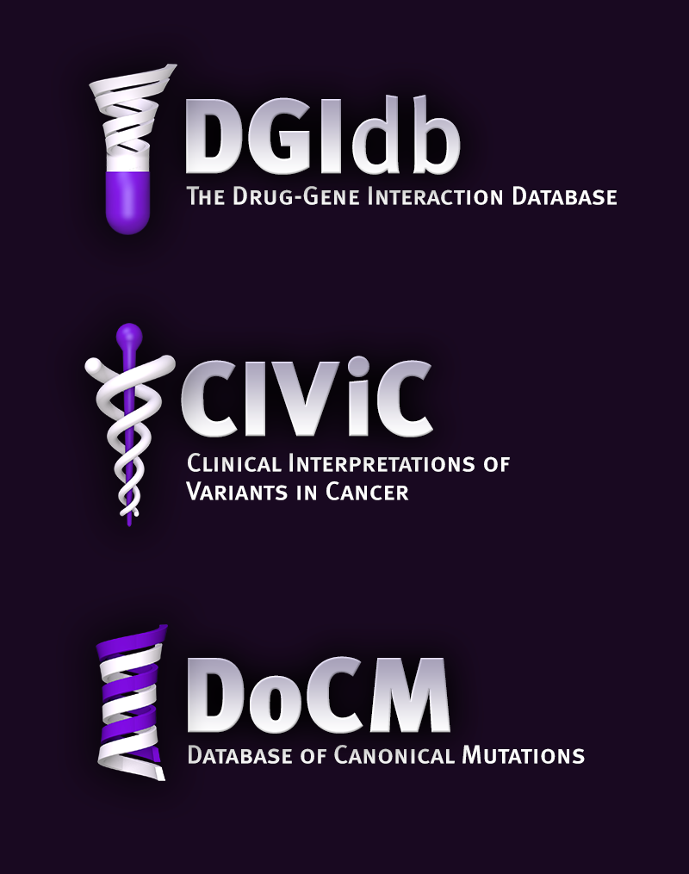

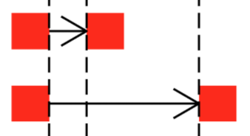
Where tools/resources do not exist we build them
www.dgidb.org
Search genes for known and potentially druggable interactions
https://github.com/griffithlab/pVAC-Seq
Personalize vaccine design
www.docm.info
Filter against highly curated set of mutations known to cause cancer
GenVisR
https://github.com/griffithlab/GenVisR
Create genomic visualizations
www.civicdb.org
Identify highly curated summaries of clinical interpretations for variants in cancer
regtools
https://github.com/griffithlab/regtools
Identify regulatory variants

Slide 7
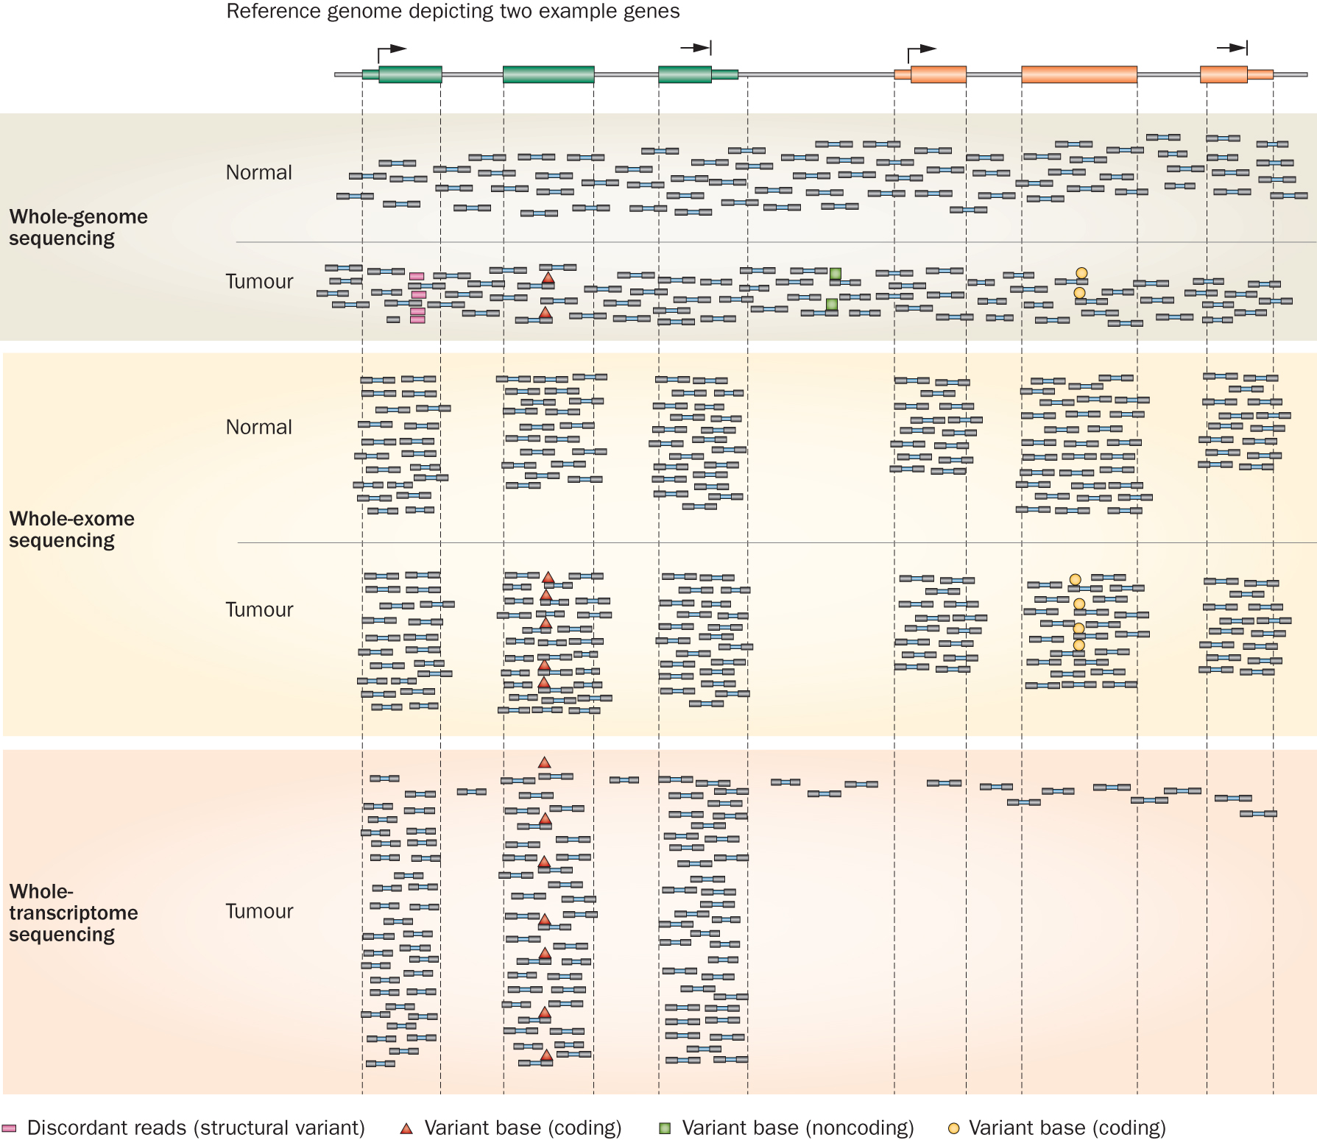
Whole genome, exome, transcriptome and other ‘omic’ sequencing allows us to detect and confirm many different variant types
‘WGS’
‘Exome’
‘RNA-seq’
Notes:
Each of these three data types, whole genome, exome and transcriptome, brings something to the table.
Whole genome gives you broad, even, and relatively unbiased coverage across the genome.
Exome gives you more focused coverage but much greater depth over the exons for a much lower cost than whole genome
RNA-seq gives you a snapshot of the transcriptome.

Slide 8
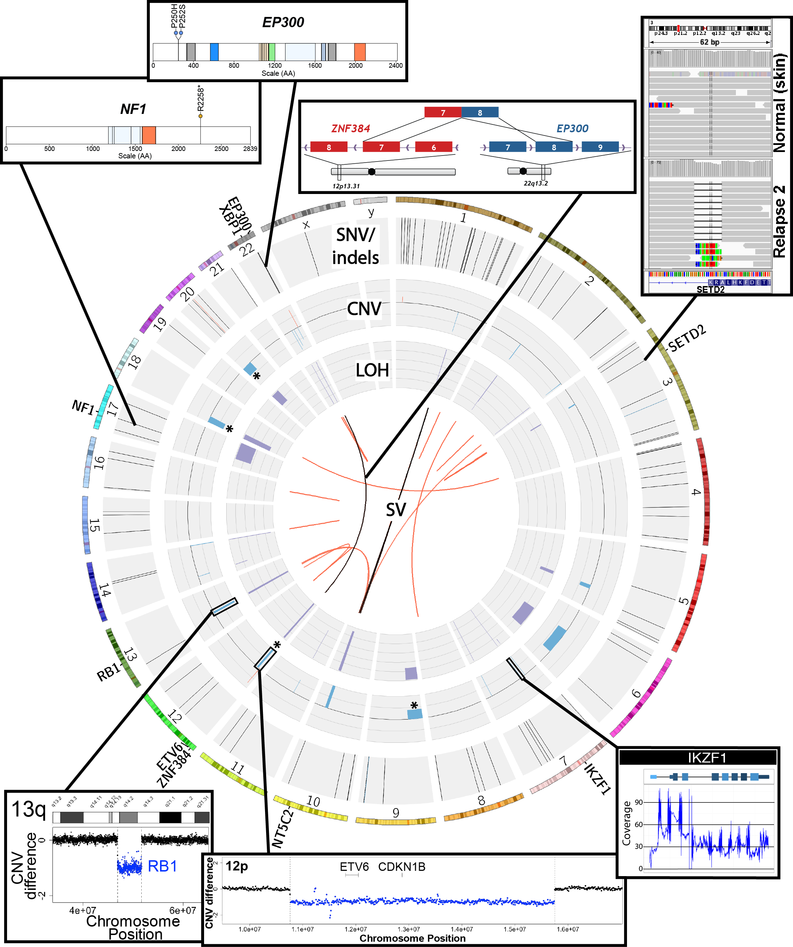
SNVs, Indels, CNVs, SVs, fusions, LOH, expression changes, methylation changes, and more
Notes:
Ultimately, an extremely comprehensive analysis was performed on this relapse tumor.
Many fascinating events were identified
The genome was characterized by a reasonable number of protein coding point mutations including those affecting EP300 and NF1.
While very little amplification was observed several rearrangements and both large and small deletions were apparent. These affected SETD2, XBP1, Ikaros, RB1, ETV6. SETD2 and NF1 were both hit twice.
An interesting EP300-ZNF384 fusion was identified.
At the time it was novel but has since been associated with other ALL patients.
While certainly interesting, none of these genomic events particularly suggested any clinical action.

Slide 9
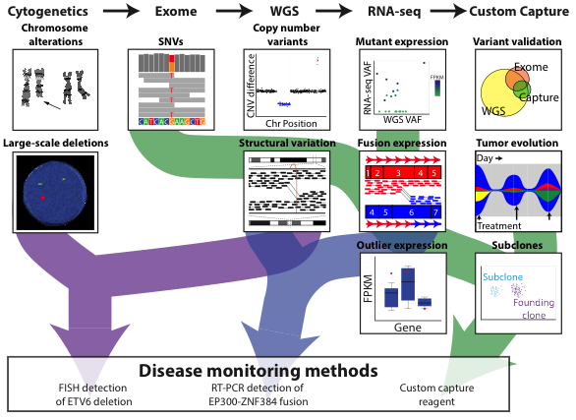
Comprehensive and integrative analysis methods are needed
Kilannin Krysiak
Notes:
As a proof-of-principle we took a very comprehensive approach. Though we balanced this with the need to complete data generation and a first version of the analysis quickly (41 days from receipt of sample to return of information).
By this time (2nd relapse), the patient had an extensive cytogenetics workup. To this we added exome, whole genome and RNA-seq.
Based on the WGS data we also created a custom NimbleGen capture reagent to cover all SNVs in the patient.
We used these data to identify SNVs and Indels, copy number variants, SVs, expressed variants, fusions, and outlier gene expression events.
The custom capture data was used largely to monitor disease burden in bone marrow samples obtained subsequent to the second relapse (and historical samples that were previously banked).

Slide 10
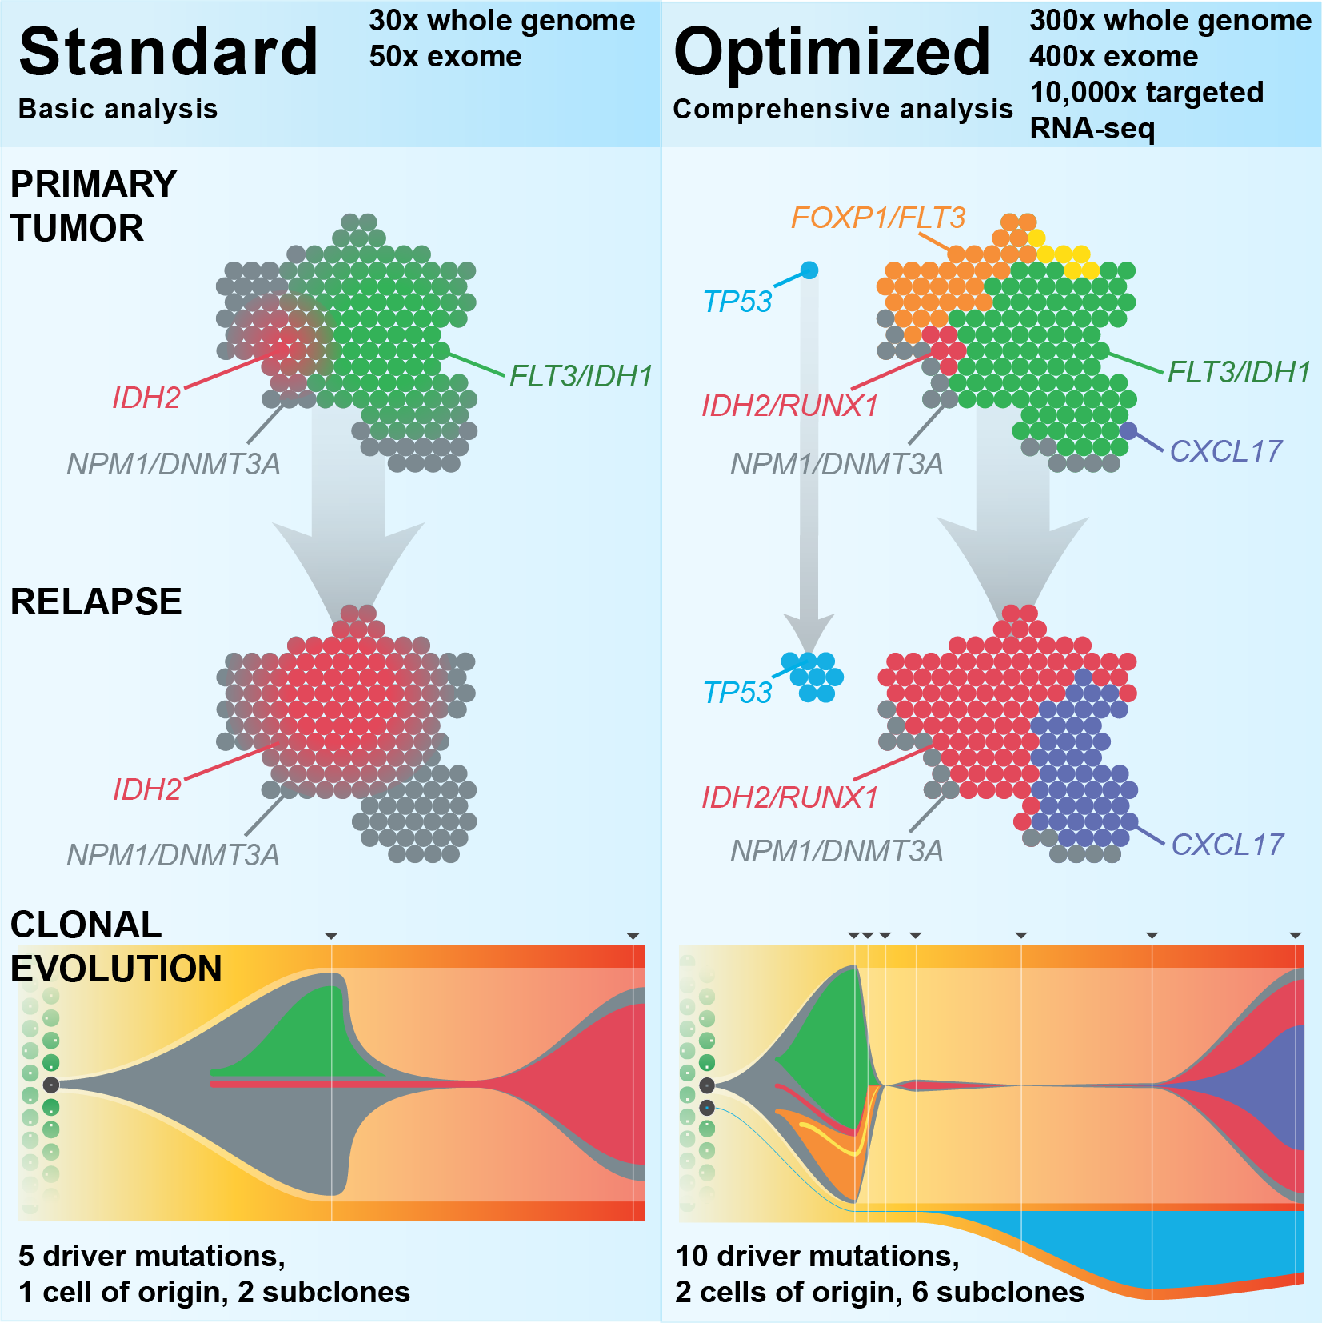
Each study often requires considerable customization
Griffith et al. 2015
Kilannin Krysiak

Slide 11
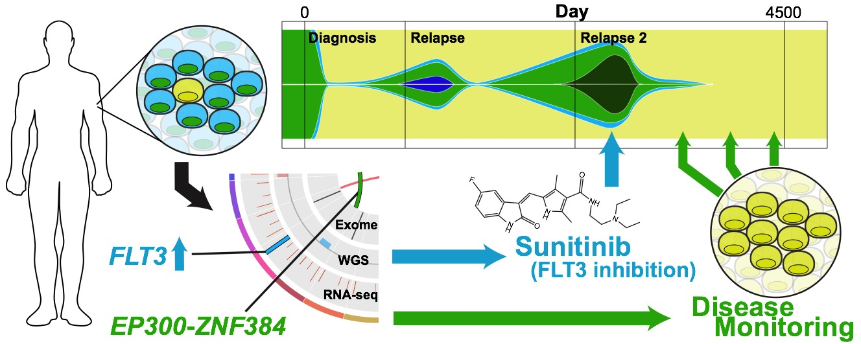
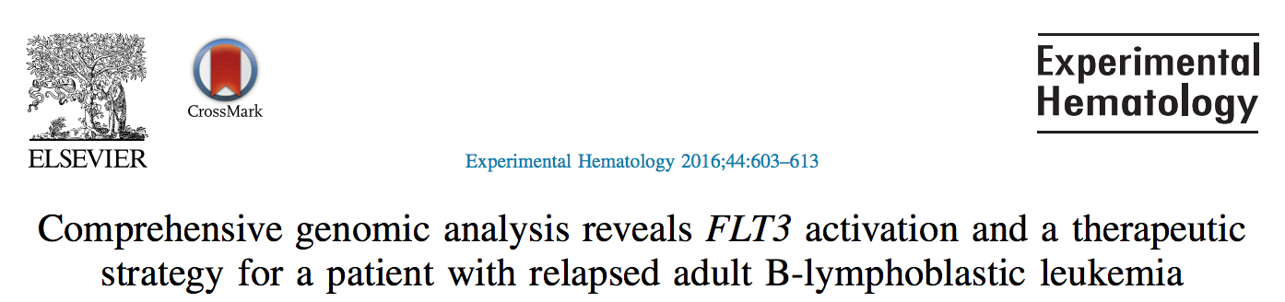
Personalized medicine requires personalized strategies
Griffith et al. 2016
Kilannin Krysiak

Slide 12
Strategies to bring genomics information to bear for as many cancer patients as possible
Precision medicine targeting of driver mutations
Leveraging passenger variants
Tracking minimal residual disease
Identifying neoepitopes
Predicting response to immunotherapy
Developing personalized vaccines

Slide 13
Precision medicine targeting of driver mutations
1980s: Development of Targeted Therapies
2000: Human Genome Sequencing Project
2001: FDA Approval for Imatinib in BCR-ABL1 CML
2014: FDA Approval for BRCA Testing
2017: FDA Approval of Pembro for MSI tumors
BRAF -> V600E -> Melanoma -> Predictive -> Vemurafenib
ERBB2 -> Amplification -> Breast -> Predictive -> Traztuzumab
EGFR -> L858R -> Lung -> Predictive -> Erlotinib
ALK -> Fusions -> Lung -> Predictive -> Crizotinib
EWSR1-FLI1 -> Fusions -> Ewing Sarcoma -> Diagnostic
DNAJB1-PRKACA -> Fusions -> flHCC -> Diagnostic
VHL -> Loss of function mutations -> Kidney -> Predisposing
… an increasingly long tail of rare but clinically relevant variants
Erica Barnell
Notes:
Notes on examples:
BRAF -> V600E -> Melanoma -> predictive?
EGFR -> L858R -> Lung -> predictive?
EGFR -> T790M -> Lung -> predictive?
ALK -> Fusions -> Lung -> predictive?
ERBB2 -> Amplification -> Breast -> predictive?
EWSR1-FLI1 -> Fusion -> Ewing Sarcome -> Diagnostic?
Secondary mutations in BCR-ABL1 that confer resistance?
PTEN Loss perhaps?
I would argue BRCA mutations should also be counted. Also, we are at the point where ER/PR/HER2/KI67 testing by RNA is cheaper and more accurate than IHC and really *should* be the clinical standard. Rolling out in less developed countries that don't have legacy dependency on IHC. NTRK fusions and inhibitors seem likely to have a wide impact
ERBB2 kinase domain mutations in breast cancer, while rare, are clearly clinically relevant
KIT mutations in GIST and some other tumors guide standard of care
There's about a dozen genes with mutations that inform FDA approved treatments and guidelines according to oncokb. Not as many as we would like but to say CML is the only example is really weird
I think the problem is that many of these are not being run routinely in the clinical setting outside of select academic hospital settings. But this is more a problem with slow/conservative clinical adoption and default resistance of insurance providers. It will take a few more years beating them over the heads with data. OHSU is planning to roll BRCA testing out to all patients in their system (hundreds of thousands or millions planned). Mary Claire King has been preaching this for years but think about how long we've known (or could impute) of the importance/value of this. Things just move show.
MSI -> nsclc -> nivolimab
Dnajb1-prkaca -> flHCC -> diagnostic
BTK -> C421 -> CLL -> predictive of resistance
Special subset of heme malignancies are defined by eosinophilia and pdgfra/b and one other gene.
Alk fusions are highly targetable.
Her2 targeting with trastuzumab changed the picture for these patients as far as I understand. Both of these are heavily represented in CIViC, and played a large role in MATCH basket trial. The data seems very much there in some of these trials, so it should only be a matter of time for it to be more accepted.
I noted the MSI (non gene entity) example, and think we should perhaps prioritize non gene entities a bit higher in our upcoming goals.
In general the variant clinical interpretations should help us address this topic more effectively. Maybe 5 years from now someone asking that same question could be directed to CIViC as part of the answer.
Prosigna (Produced by Nanostring) is a panel of ~50 RNA transcripts that predicts breast caner recurrence and is now included in international guidelines for breast cancer surveillance
Veracyte produces a bunch of genomic diagnostics including Afirma (Fine Needle Aspiration analysis to diagnose thyroid malignancy), Percepta (lung cancer diagnosis), and Envisia (IPF diagnosis)

Slide 14
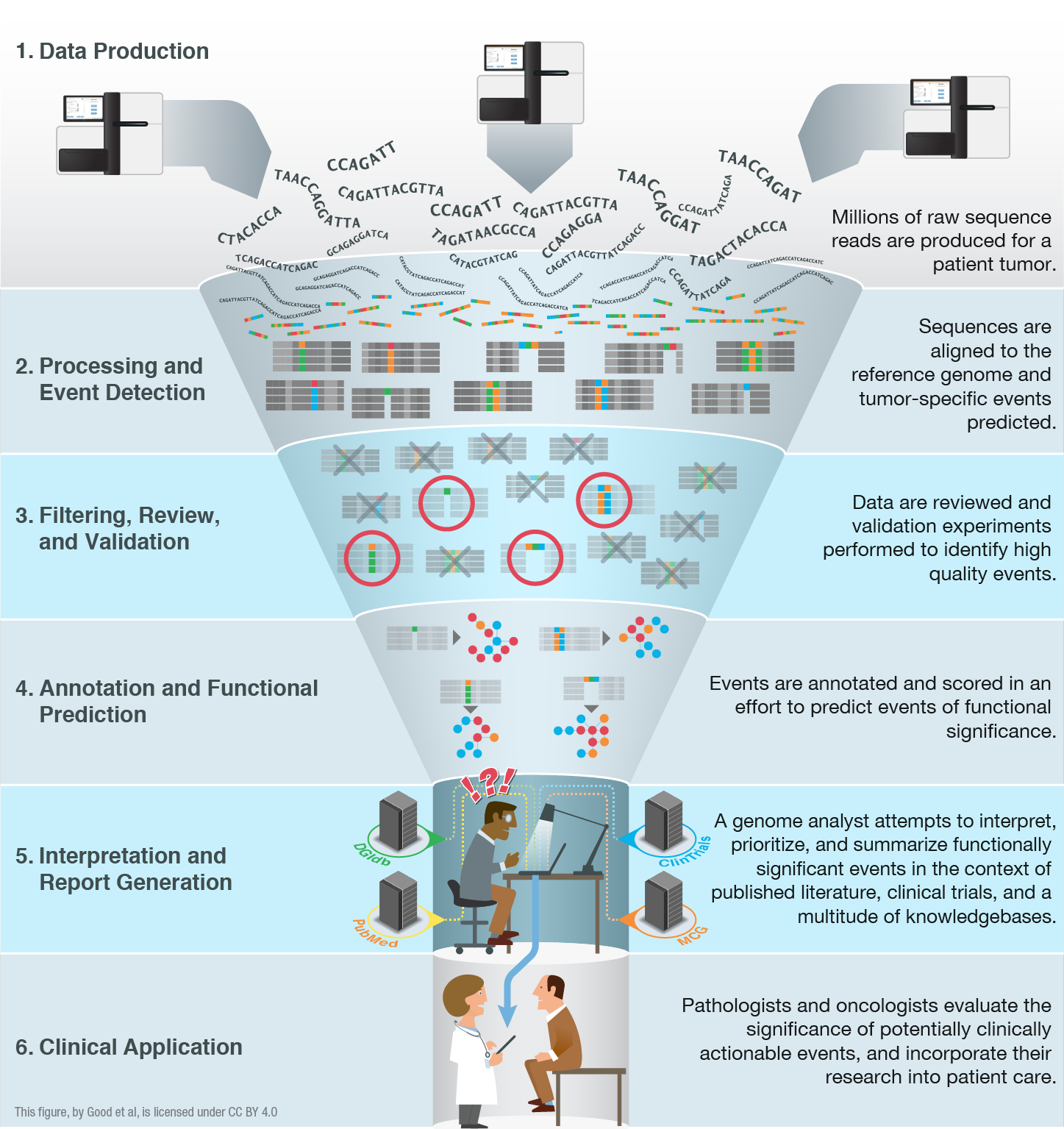
High-throughput sequencing has been largely automated allowing rapid identification of somatic and germline variants
Good BM, Ainscough BJ, McMichael JF, Su AI, Griffith OL. 2014. Genome Biology. 15(8):438.
Joshua McMichael
Notes:
We have an embarrassment of riches with all of the –omic events now being detected (though there is plenty of room for improvement!).
We are starting to have a handle on doing this routinely and quickly. We can generate the raw data, feed it into automated pipelines that process the data and predict genomic events. Filtering, review and validation thins these lists down to somewhat tractable counts of 10s to 100s of events. Where we are really stuck now is at the interpretation and report generation stage. This is a major bottleneck. The ‘genome analysts’ who have the skill sets to assemble final reports that a clinician might find useful are completely swamped.
One way to address this I already talked about. Education. We can train more of these genomics experts. But we also need to harness informatics strategies to make their job easier and address the bottleneck. With that in mind we are pursuing various data mining, crowd sourcing, natural language processing, etc.

Slide 15
Interpretation and visualization of genomic alterations remains the bottleneck for realizing precision medicine
Good BM, Ainscough BJ, McMichael JF, Su AI, Griffith OL. 2014. Genome Biology. 15(8):438.
Joshua McMichael
Notes:
We have an embarrassment of riches with all of the –omic events now being detected (though there is plenty of room for improvement!).
We are starting to have a handle on doing this routinely and quickly. We can generate the raw data, feed it into automated pipelines that process the data and predict genomic events. Filtering, review and validation thins these lists down to somewhat tractable counts of 10s to 100s of events. Where we are really stuck now is at the interpretation and report generation stage. This is a major bottleneck. The ‘genome analysts’ who have the skill sets to assemble final reports that a clinician might find useful are completely swamped.
One way to address this I already talked about. Education. We can train more of these genomics experts. But we also need to harness informatics strategies to make their job easier and address the bottleneck. With that in mind we are pursuing various data mining, crowd sourcing, natural language processing, etc.

Slide 16
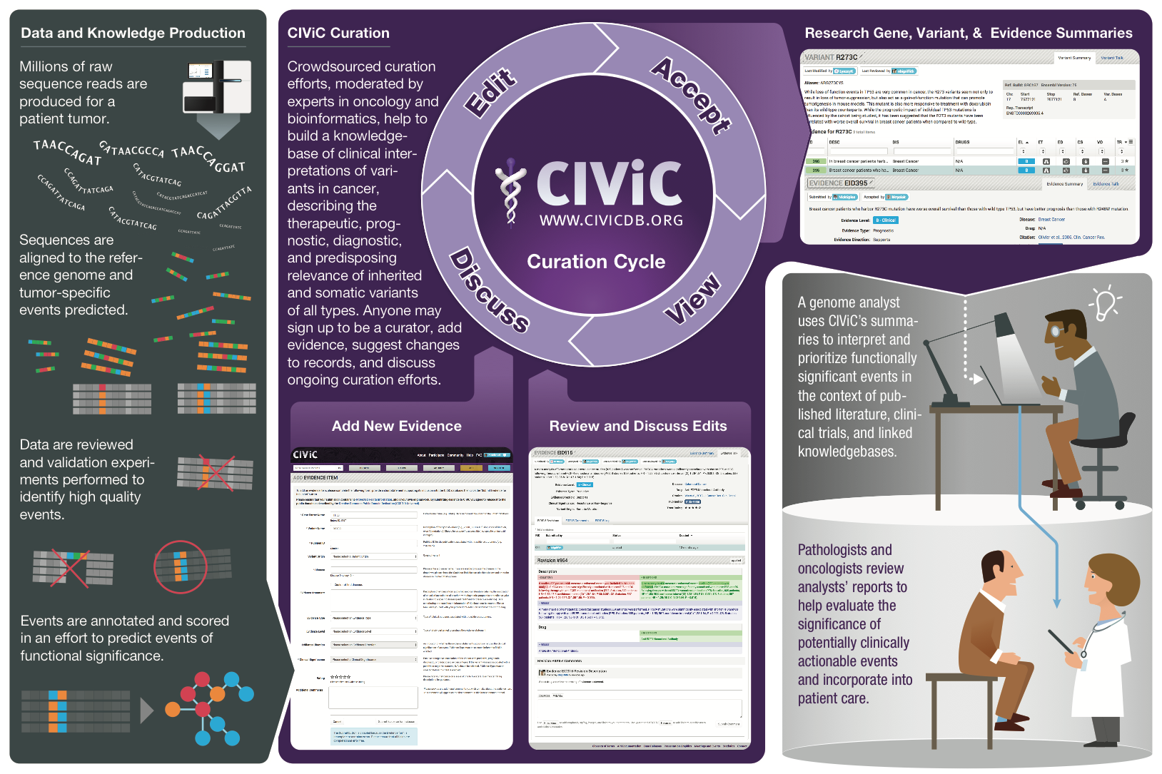
We created CIViC to address this need – an open knowledgebase and curation system for clinical interpretation of variants in cancer
www.civicdb.org
Joshua McMichael
Notes:
Goal: Create a resource that stores such interpretations, facilitates their creation, allows them to evolve rapidly (with provenance), and makes them publicly available for automated report generation

Slide 17
Strategies to bring genomics information to bear for as many cancer patients as possible
Precision medicine targeting of driver mutations
Leveraging passenger variants
Tracking minimal residual disease
Identifying neoepitopes
Predicting response to immunotherapy
Developing personalized vaccines

Slide 18
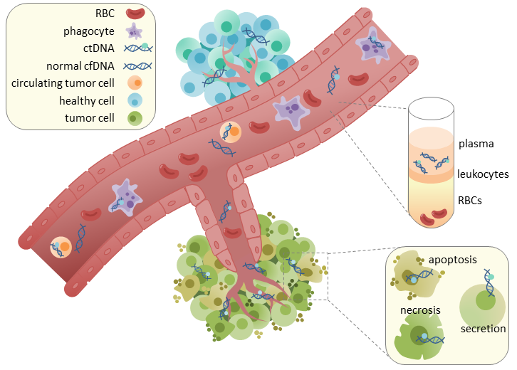
Circulating tumor DNA (ctDNA) could allow generalized tracking in any cancer type
Wikimedia Commons (CC BY-SA 4.0)
Notes:
https://en.wikipedia.org/wiki/Circulating_tumor_DNA#/media/File:CtDNA_in_circulation.png

Slide 19
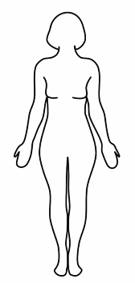
ctDNA tracking in triple negative breast cancer
Blood for ctDNA
Blood for ctDNA
Blood for ctDNA
Blood for ctDNA every 6 months X 5 years
Research biopsy
Research biopsy
Research biopsy at surgery
DOCETAXEL AND CARBOPLATIN
ADJUVANT CHEMOTHERPY AT TREATING MDs DISCRETION
SURGERY
Stage 2/3TNBC
Tumor/ctDNA sequencing to identify mutations
Tumor/ctDNA sequencing to identify mutations
Tumor/ctDNA sequencing to identify mutations
Tumor/ctDNA sequencing to identify mutations
Clinical Trial: NCT02124902 (Contact PI: Foluso Ademuyiwa)
Notes:
- Of course doing this in blood tumors is one thing, doing it in solid tumors adds a level of difficulty.

Slide 20
Strategies to bring genomics information to bear for as many cancer patients as possible
Precision medicine targeting of driver mutations
Leveraging passenger variants
Tracking minimal residual disease
Identifying neoepitopes
Predicting response to immunotherapy
Developing personalized vaccines

Slide 21
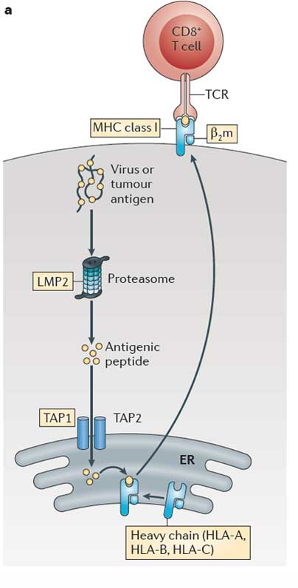
Invoking an adaptive immune response against the tumor (focus on CD8+ T cells)
4. T cell receptor that uniquely matches the tumor peptide
3. Neoantigen peptide presented by MHC
1. Tumor produces a unique peptide corresponding to a somatic mutation
2. Processing and presentation of the tumor specific peptide
Notes:
HLA typing essential to epitope prediction
In immunoepitope prediction, we identify novel, cancer-specific peptides that bind to MHC class I molecule of a specific HLA type
NOTE: In the cancer disease state the interaction of PD-L1 (ligand) on the tumor cell surface with PD-1 (receptor) on a T-cell reduces T-cell function signals to prevent the immune system from attacking the tumor cells. Checkpoint blockade therapies block this interaction by targeting either side of the interaction.
NOTE: CTLA4 is up-regulated in activated T-cells where (when bound to CD80 or CD86 on the surface of antigen presenting cells) it acts as an off switch for the immune system.

Slide 22
Neoepitope characterization workflow
HLA typing
Jasreet Hundal & Katie Campbell
Shirley X. Liu, Elaine R. Mardis. Applications of Immunogenomics to Cancer. Cell Press. 2017.
Notes:
MHC multimers are oligomeric forms of MHC molecules, designed to identify and isolate T-cells with high affinity to specific antigens amid a large group of unrelated T-cells.

Slide 23
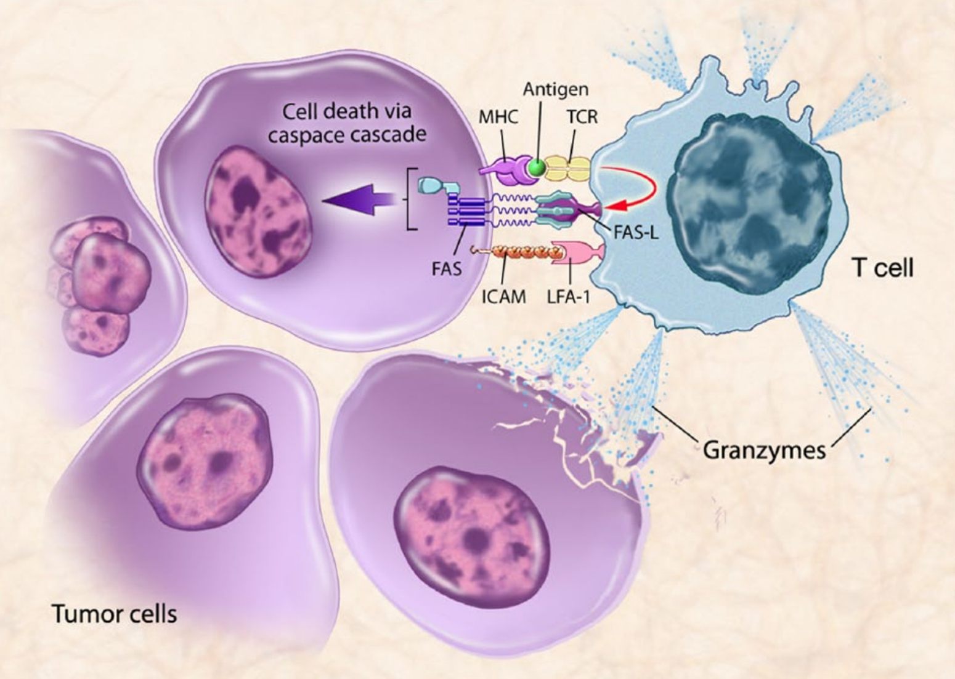
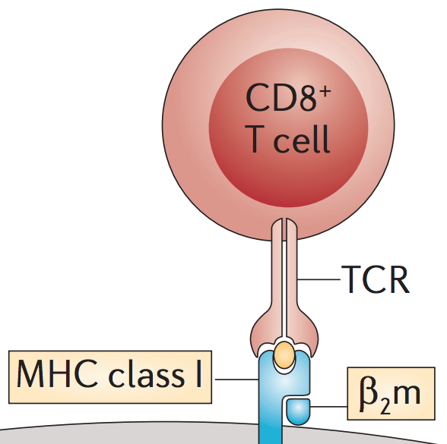
T cell mediated cell death
Singh and Gulley, 2014
Notes:
“T-cell mediated killing of tumor cells. Therapeutic cancer vaccines are designed to stimulate immune cells to target specific tumor-associated antigens (TAAs) overexpressed on cancer cells. Antigen-presenting cells (APCs) present antigens to the immune system via major histocompatibility complex molecules, which bind to T-cell receptors (TCRs). Activated T-cells travel to the tumor, recognized by the TAAs presented in the context of the major histocompatibility complex (MHC), leading to T cell-mediated killing of tumor cells by immunogenic cell death. When T cells specific for that MHC-antigen complex become activated, they upregulate Fas ligand, bind to Fas on the tumor cell, and initiate a downstream caspase cascade, leading to tumor cell apoptosis. Activated T cells can also release granzymes that can kill the target cell and surrounding tumor cells. Thus, expression of MHC and TAAs, as well as Fas, on the tumor cell enables T-cell recognition and killing of tumor cells. FAS-L, Fas-ligand; ICAM, intracellular adhesion molecule; LFA-1, lymphocyte function-associated antigen 1.”

Slide 24
Personalized cancer vaccine trials
Kidney Cancer (n = 15 patients)
PolyImmune {Durvalumab (MEDI4736) and Tremelimumab} & Vaccine Orchestrated Treatment for Patients With Advanced/Metastatic Renal Cell Carcinoma (NCT03598816). Collaboration with MedImmune.
Lung Cancer (n = 15 patients)
A Personal Cancer Vaccine (NEO-PV-01) With Pembrolizumab and Chemotherapy for Patients With Lung Cancer (NCT03380871). Collaboration with Neon Therapeutics and Merck.
Glioblastoma (n = 30 patients)
Neoantigen-based Personalized Vaccine Combined With Immune Checkpoint Blockade Therapy in Patients With Newly Diagnosed, Unmethylated Glioblastoma (NCT03422094)
Breast Cancer (n = 54 patients)
Neoantigen DNA Vaccine Alone vs. Neoantigen DNA Vaccine Plus Durvalumab in Triple Negative Breast Cancer Patients Following Standard of Care Therapy (NCT03199040). Collaboration with MedImmune.
Safety and Immunogenicity of a Personalized Polyepitope DNA Vaccine Strategy in Breast Cancer Patients With Persistent Triple-Negative Disease Following Neoadjuvant Chemotherapy (NCT02348320)
Follicular Lymphoma (n = 20 patients)
Personalized Tumor Vaccine Strategy and PD-1 Blockade in Patients With Follicular Lymphoma (NCT03121677). Collaboration with Bristol-Myers Squibb.
Prostate Cancer (n = 20 patients)
Neoantigen DNA Vaccine in Combination With Nivolumab/Ipilimumab and PROSTVAC in Metastatic Hormone-Sensitive Prostate Cancer (NCT03532217). Collaboration with Bristol-Myers Squibb.
Pancreatic Cancer (n = 15 patients)
Neoantigen DNA Vaccine in Pancreatic Cancer Patients Following Surgical Resection and Adjuvant Chemotherapy (NCT03122106).
Melanoma (n = 12 patients)
Dendritic Cell Vaccination in Patients With Advanced Melanoma (NCT03092453). Collaboration with UPenn/Parker ICI.

Slide 25
Genomic data visualization and interpretation

Slide 26
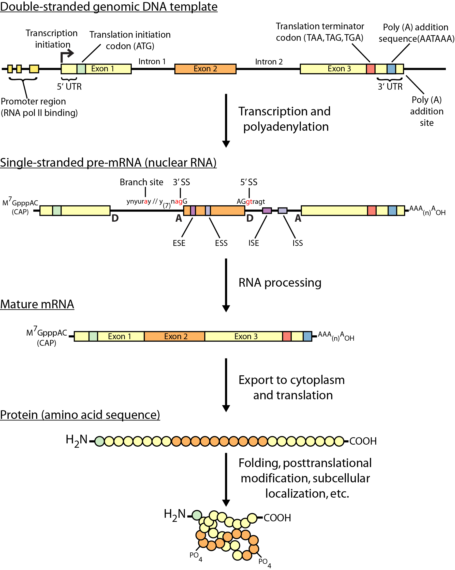
Review of central dogma

Slide 27
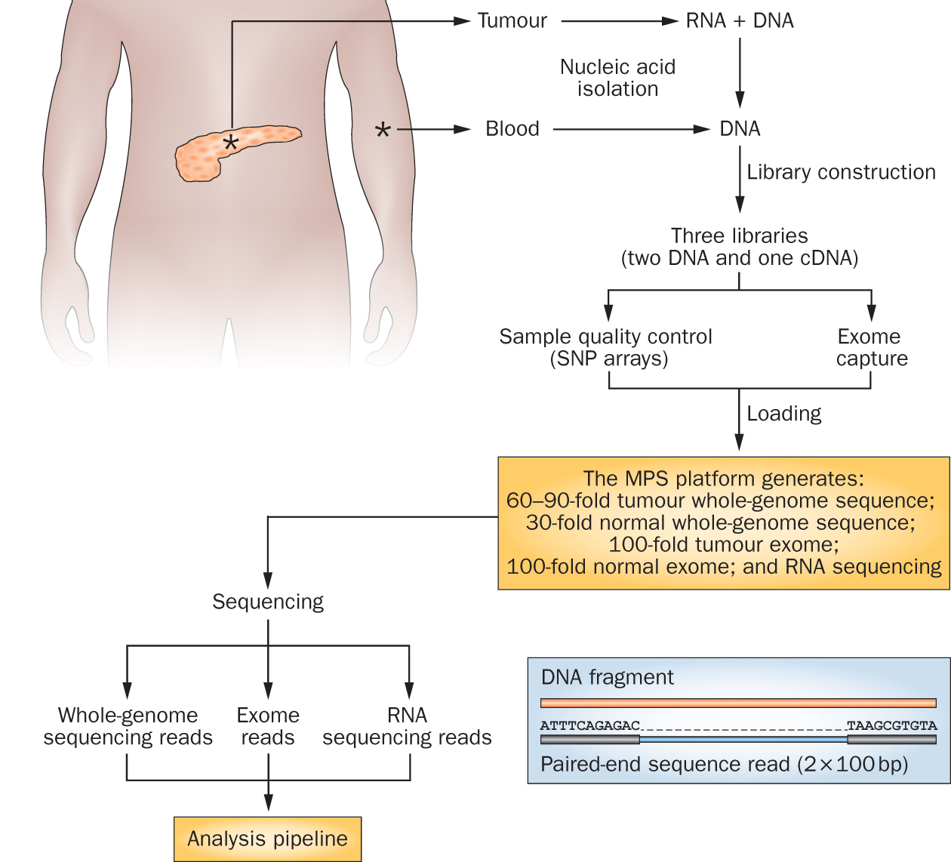
Genomics research has exploded with the rapid advances in DNA sequencing technologies
Notes:
We sequence a lot of things at the Genome Institute. But my research interest is fairly focused on clinical cancer sequencing. The idea here is that we start with a patient, sometimes starting at diagnosis but often starting at the point where they have exhausted standard of care options.
From these patients we get a tumor sample and a reference normal sample (usually blood). From the tumor we isolate DNA and RNA and from the normal we isolated DNA. This trio of samples is subjected to library construction followed by whole genome, exome, and transcriptome sequencing. This data flows into our analysis systems and we attempt to detect somatic events that might be relevant to cancer biology or treatment. This involves detecting single nucleotide variants, small insertions and deletions, large copy number amplifications and deletions, gene and isoform expression levels, structure rearrangements, expressed gene fusions, and detection of tumor associated viruses.

Slide 28
Whole genome, exome and transcriptome sequencing allows us to detect and confirm many different variant types
‘WGS’
‘Exome’
‘RNA-seq’
Notes:
Each of these three data types, whole genome, exome and transcriptome, brings something to the table.
Whole genome gives you broad, even, and relatively unbiased coverage across the genome.
Exome gives you more focused coverage but much greater depth over the exons for a much lower cost than whole genome
RNA-seq gives you a snapshot of the transcriptome.

Slide 29
Why do we create visualizations of genomic data?
Data exploration and interpretation of results
QC analysis
Understanding whether/how an experiment worked
Discovery
Communication
Slides for presentations
e.g. Keynote, Powerpoint, etc.
Figures for publications
e.g. PDFs, PNGs, etc.
Illustrator, Gimp, Inkscape, etc.
R and R Studio

Slide 30
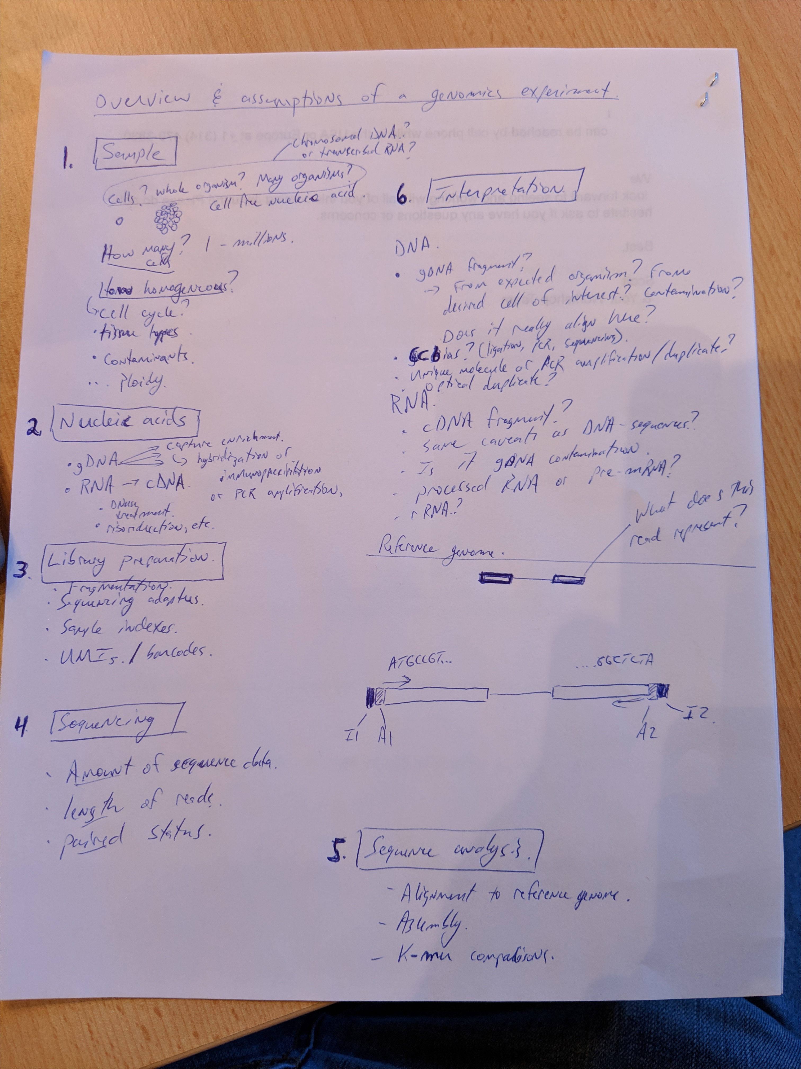
Interactive exercise on interpretation of data

Slide 31
Genome browsers

Slide 32
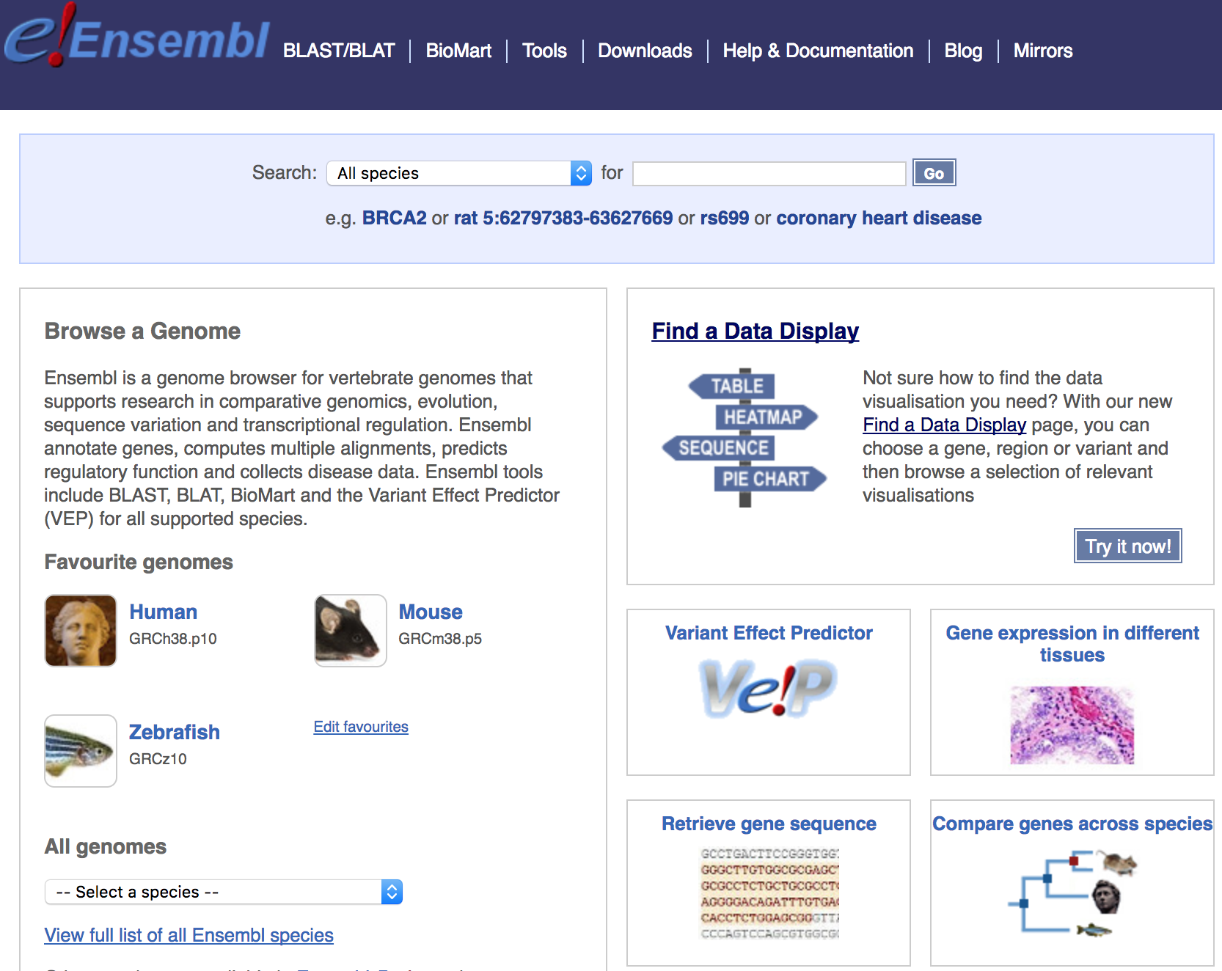
Genome browsers - Ensembl

Slide 33
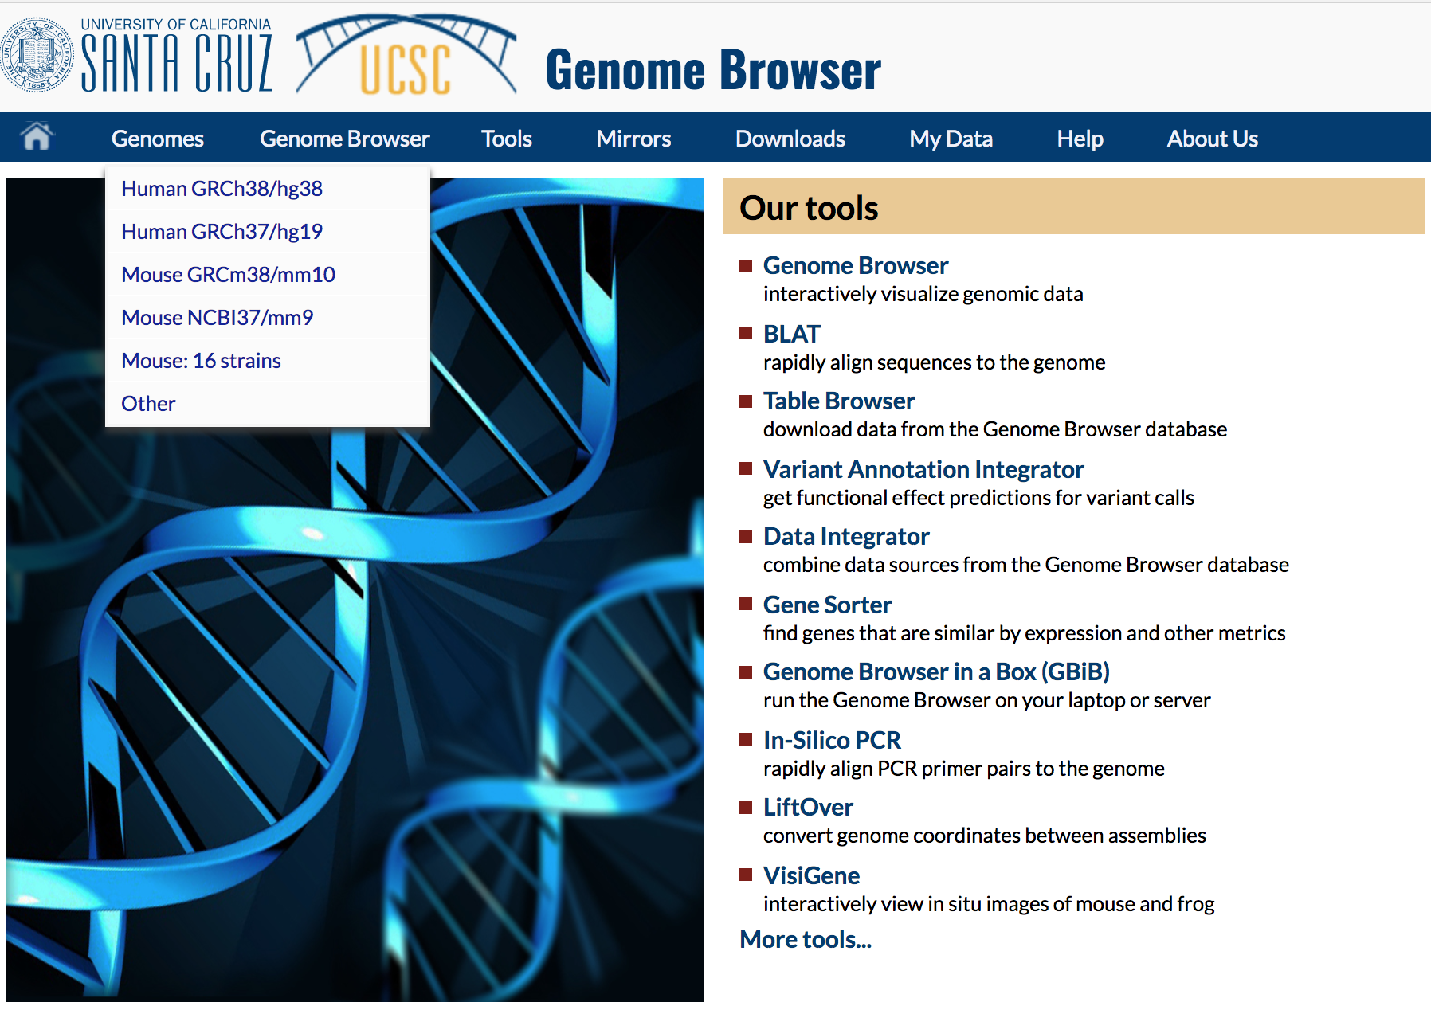
Genome browsers - UCSC

Slide 34
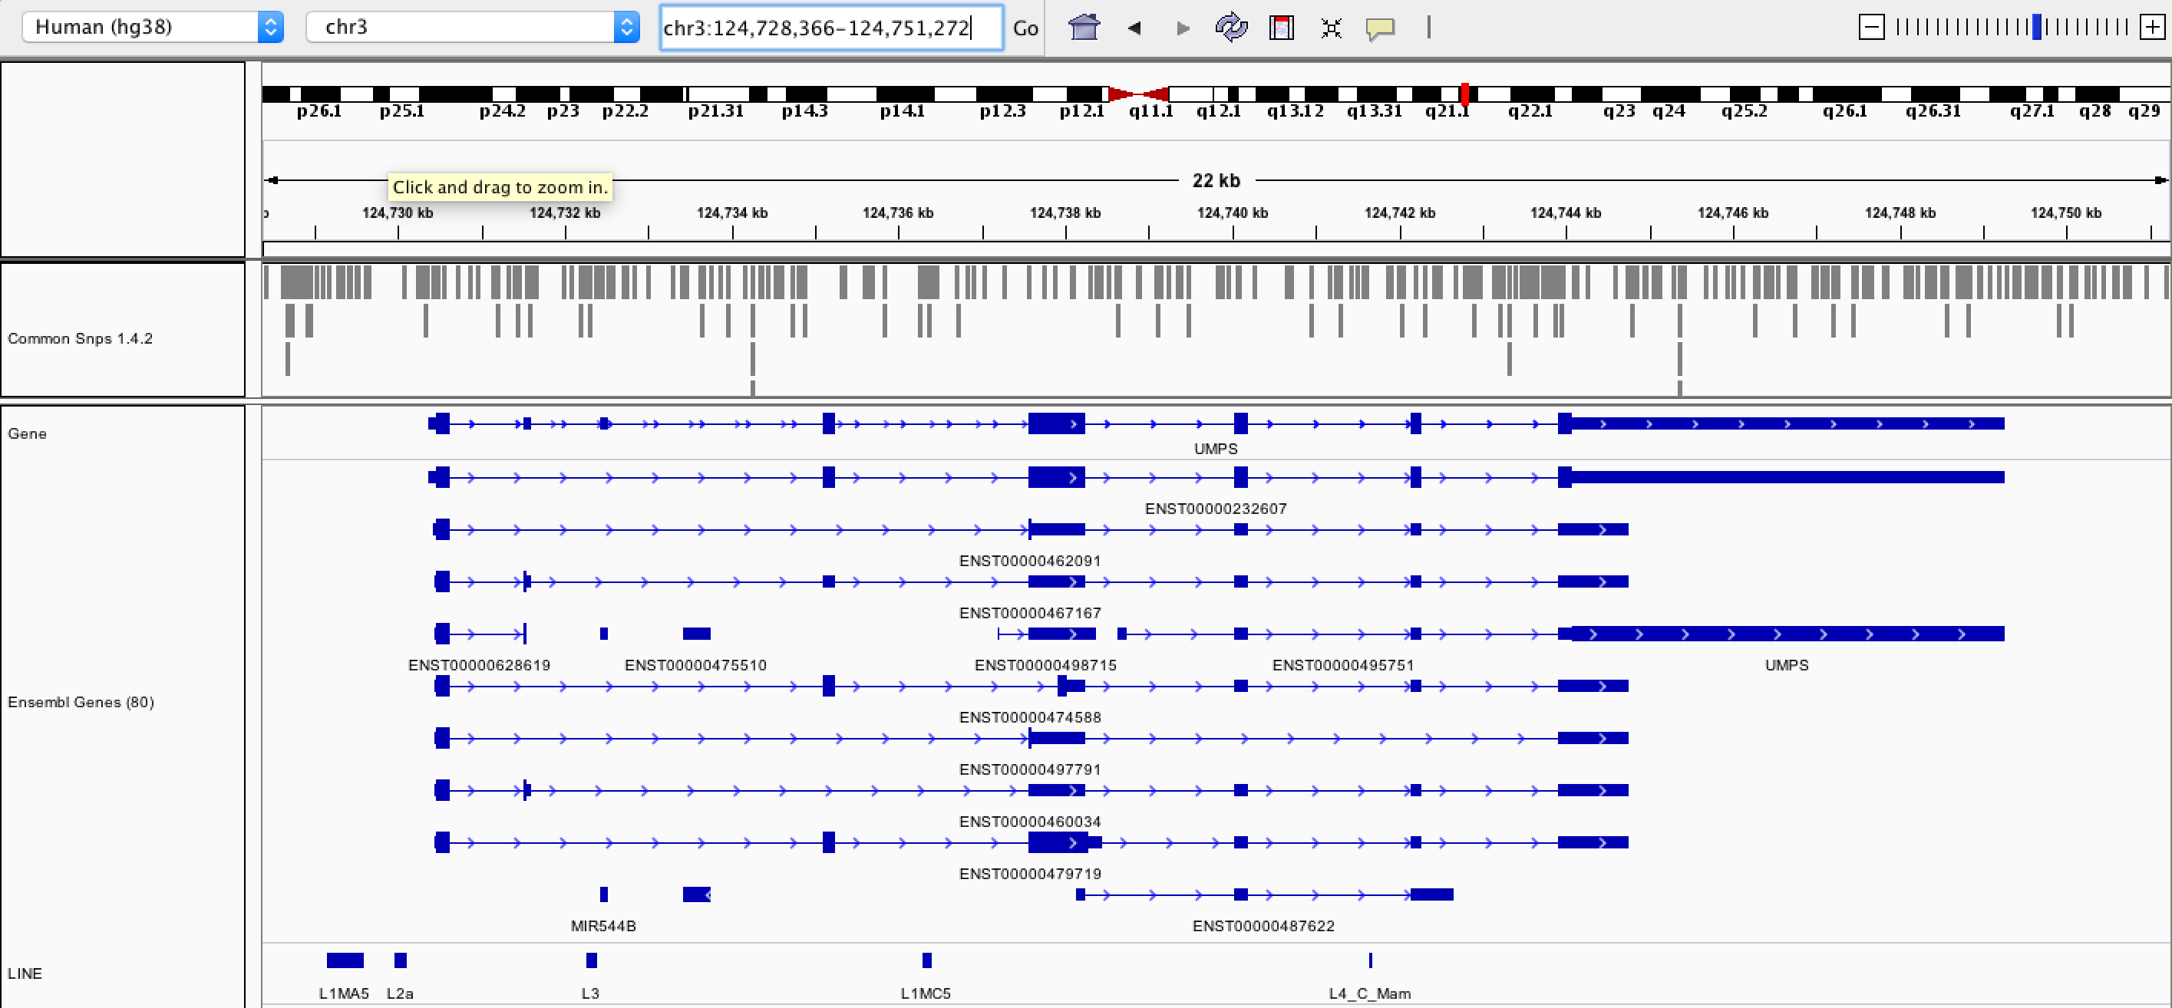
Genome browsers - IGV

Slide 35
Fundamentals of data visualization

Slide 36
Fundamentals of data visualization
Where to learn more about the art and science of visualization:
Collection of 40 Nature Methods articles on data visualization: “Points of View” Articles
Visual design principles lecture

Slide 37
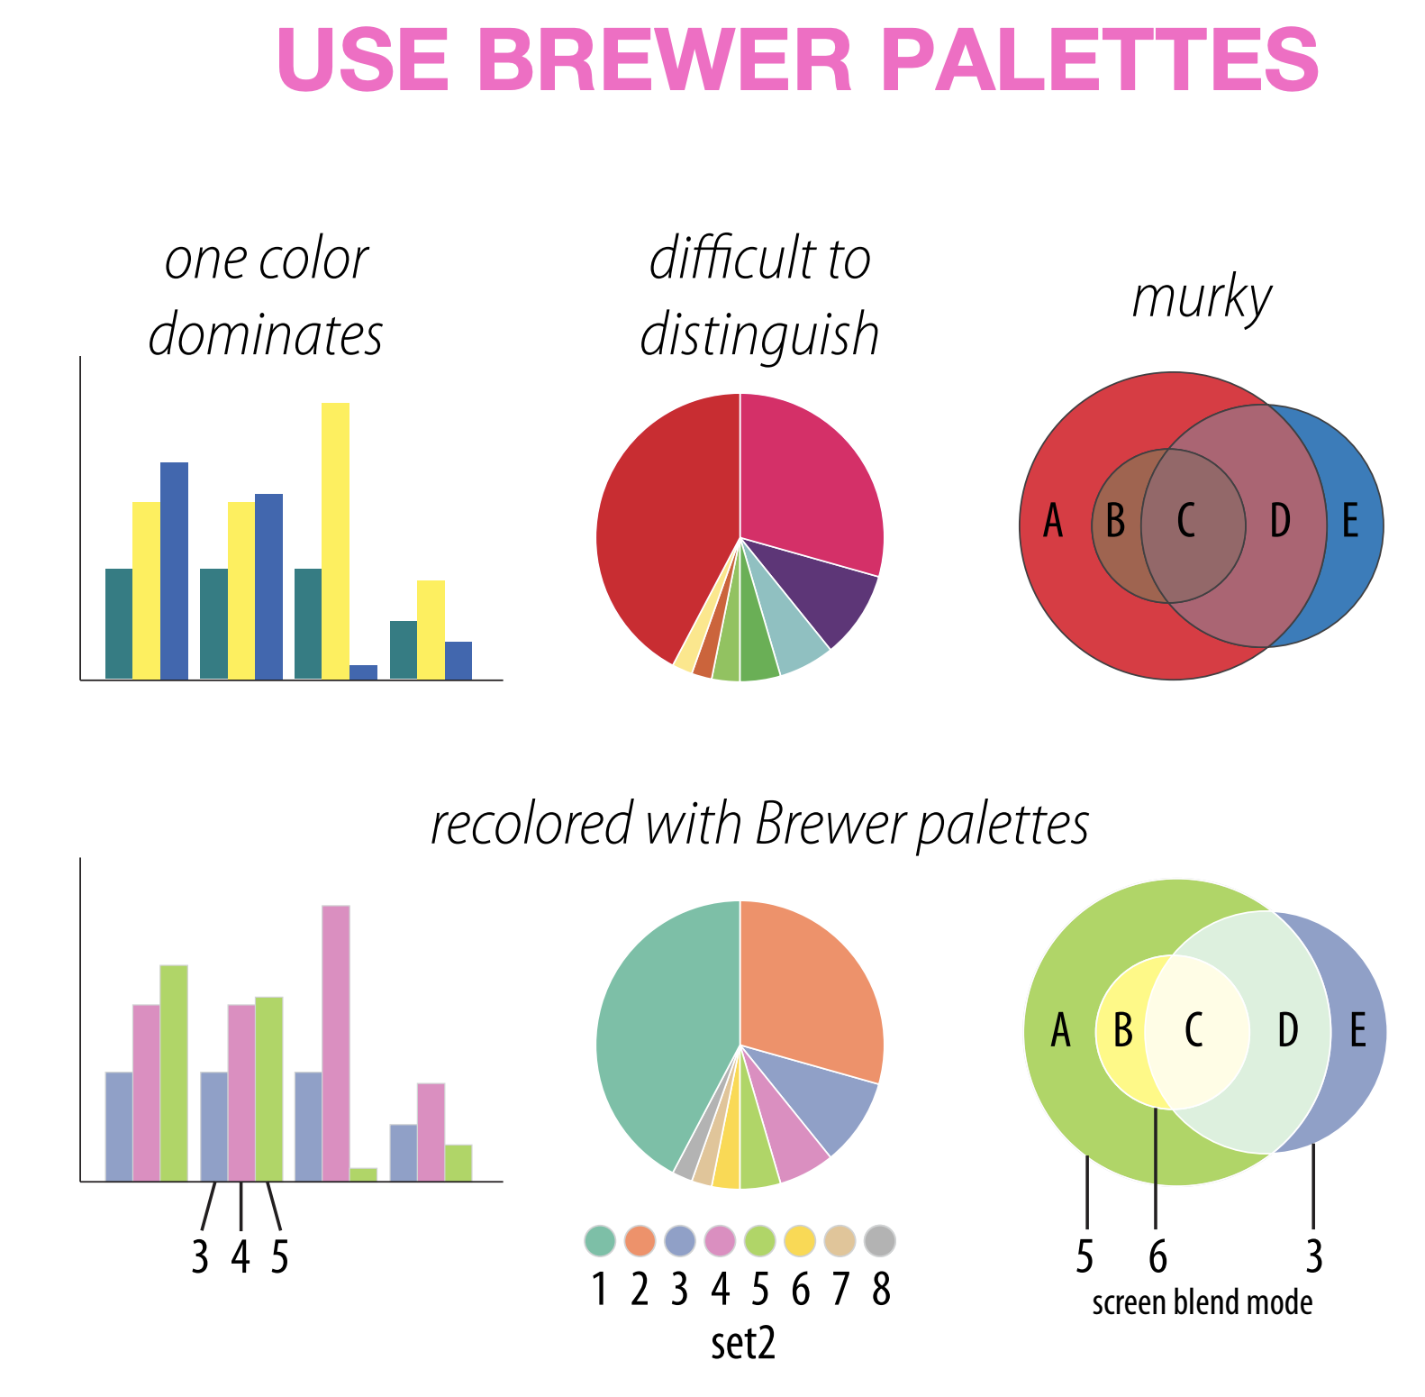
Which series is more effective (top or bottom)?
Martin Krzywinski

Slide 38
Which series is more effective (top or bottom)?
Martin Krzywinski

Slide 39
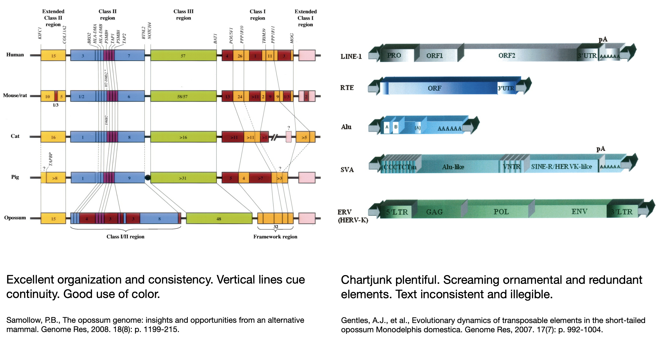
Which is more effective (left or right?)
Martin Krzywinski

Slide 40
Which is more effective (left or right?)
Martin Krzywinski

Slide 41
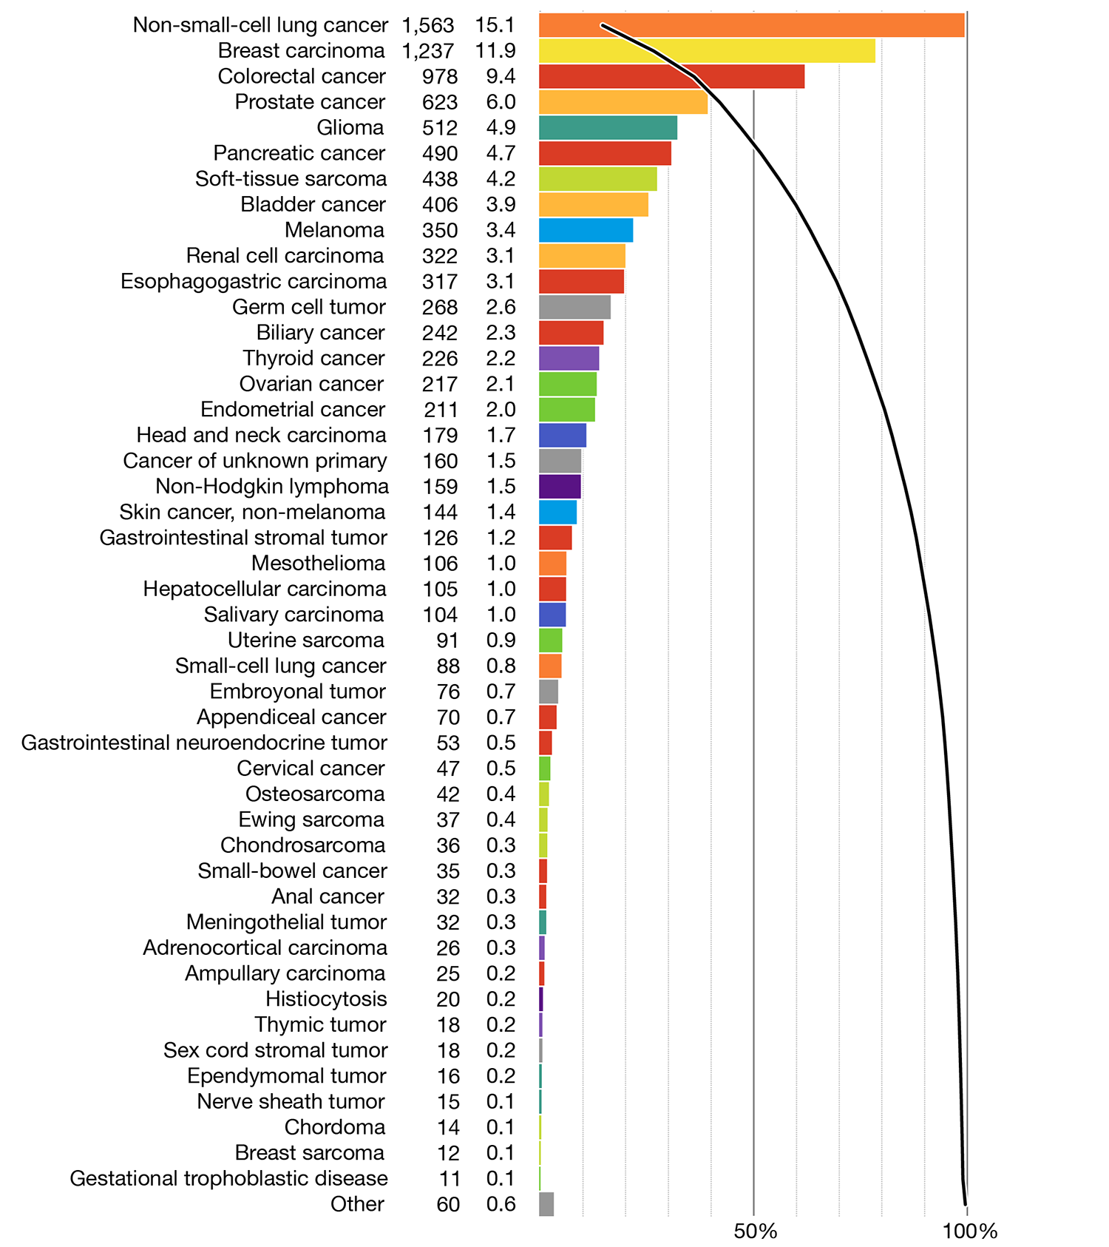
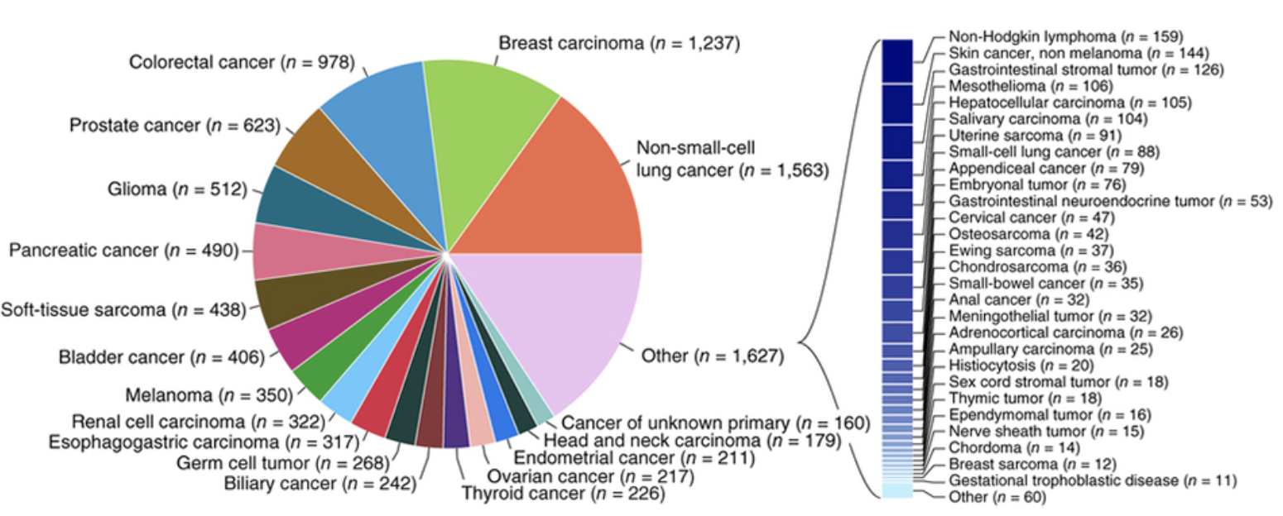
Which is more effective (left or right?)
Martin Krzywinski

Slide 42
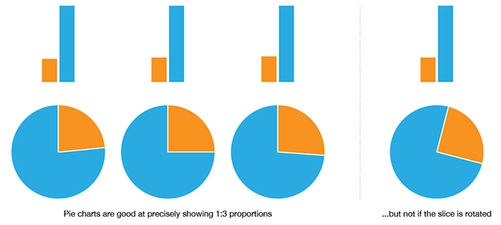
When to use a pie chart
Martin Krzywinski
Notes:
The pie chart is more intuitive than a bar plot when you have two numbers in a 1:3 proportion. Even then, it only works well when the slice is aligned. Basically if your data is more complex than this, the pie chart starts to suck pretty quickly.

Slide 43
When to not use a pie chart
Ahmet Zehir et al. (2017) Nature Medicine doi:10.1038/nm.4333
Hard to judge proportions
Poor use of color
Hard to read labels
Over ½ of the categories had to broken out of the pie chart
Martin Krzywinski

Slide 44
Same data with a redesigned approach
Martin Krzywinski
Notes:
Note the use of colors that are easy to distinguish from one another.
Now all data is displayed in the same way
Now we have bot the absolute numbers of cases, and the proportions of total listed on the left
Now we are able to show them in descending order. Instead of searching and parsing the relative size of the pie slices.
Finally, note the overlaid line that we can use to assess the cumulative proportion of all cases represented by the top N categories.

Slide 45
Selected articles on fundamentals of data viz
Visualizing samples with box plots
Circos plots
When to use (and not use) pie charts
Resources for choosing colors
http://colorbrewer2.org/
http://mkweb.bcgsc.ca/color/
Understanding and using Color Palettes
Color palettes for color blindness
Names for >9000 colors
Including 40 beer colors
Credit to Martin Krzywinski for his extensive work in this area and many of the above resources

Slide 46
Best practices in visualization

Slide 47
Best practices from this workshop
*Always* label axes
Consider readability of font size
Avoid vertical or angled text if possible
Avoid unnecessary use of color, point shapes, etc.
Chose colors wisely
If individual data points are being plotted and have started to really pile up on top of each other consider using a density function
Always be transparent about what data manipulation is taking place (e.g. log scale, filtering of outliers, etc.)

Slide 48
Best practices from the experts
Ten Simple Rules for Better Figures (Rougier et al. 2014):
Scientific visualizations should act as a “a graphical interface between people and data”. Try to follow these rules.
Know Your Audience
Identify Your Message
Adapt the Figure to the Support Medium
Captions Are Not Optional
Do Not Trust the Defaults
Use Color Effectively
Do Not Mislead the Reader
Avoid “Chartjunk”
Message Trumps Beauty
Get the Right Tool

Slide 49
Example visualizations using R

Slide 50
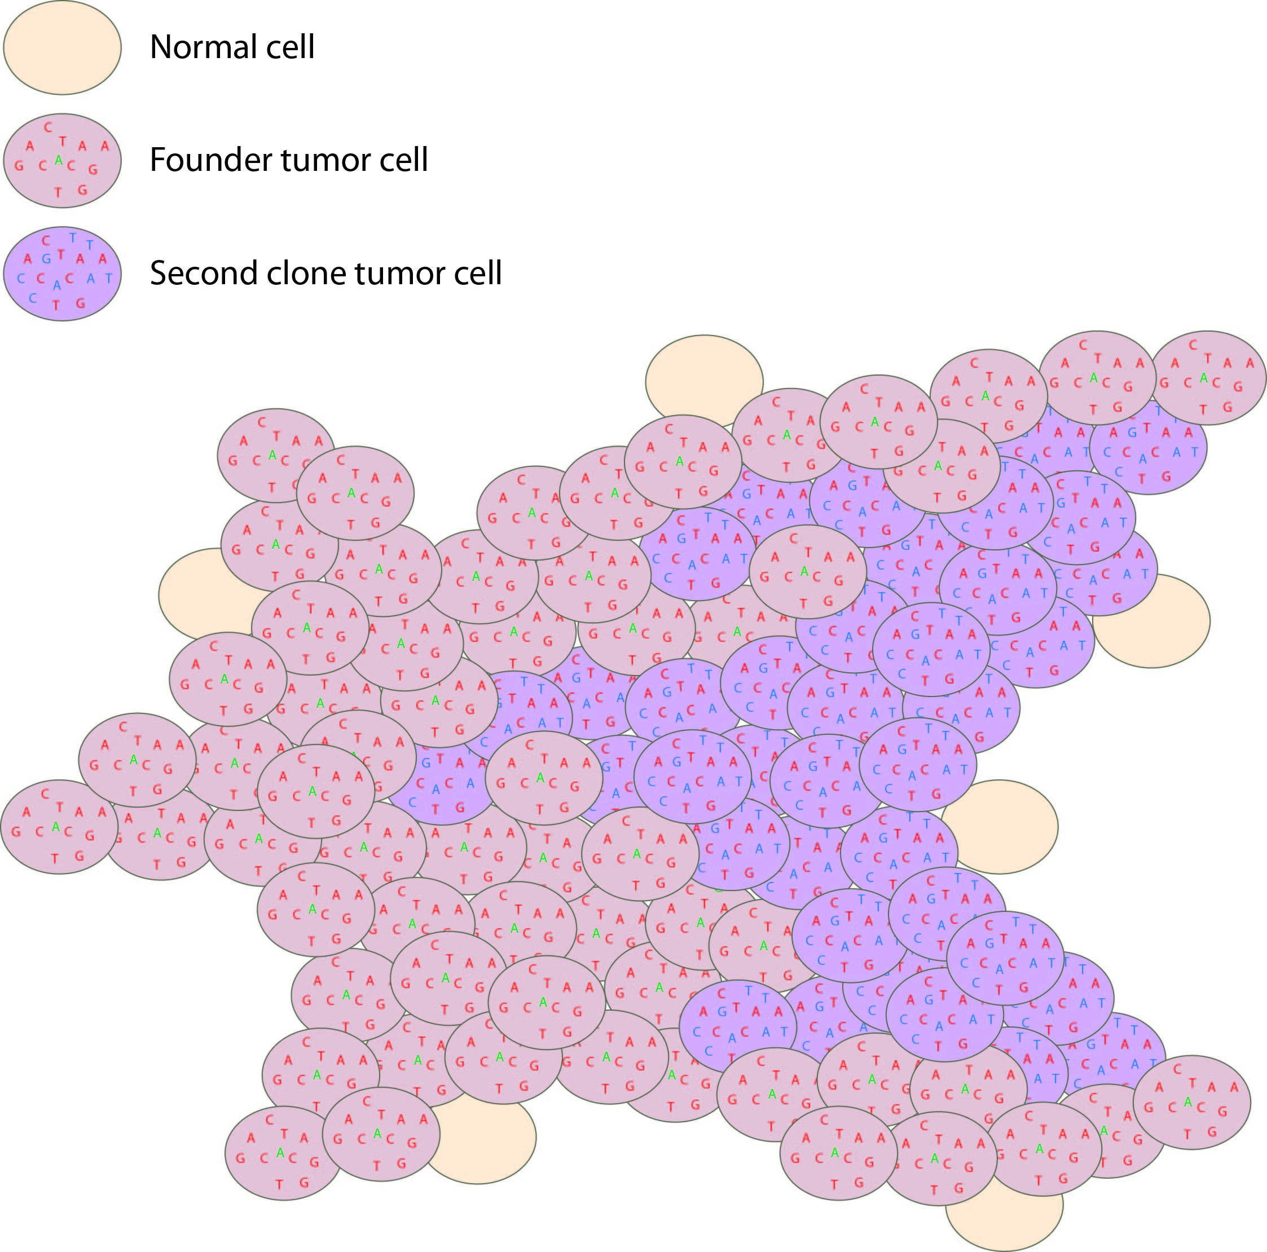
Histogram and scatterplot to define cell populations
Tumor variant allele frequency
Proportion
NF1
Read coverage (X)
WGS data
Tumor variant allele frequency
Tumor variant allele frequency

Slide 51
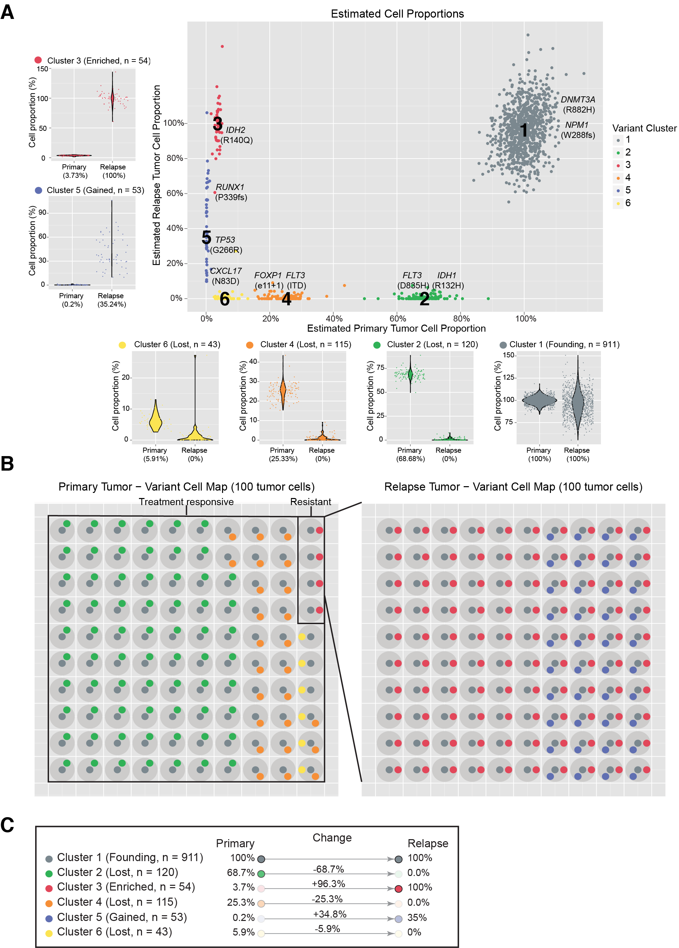
Clustering to define to distinct cell populations
Notes:
If we overlay each of these mutations on the rest of the platinum variants and use a clonality inference tools like SciClone we can resolve 6 different sub-clones, each with a couple driver mutations present. Except sub-clone 6. Based on our experiences so far we probably still haven’t sequenced deeply enough to find a driver event in that sub-clone yet.
You can see how in each of the surrounding plots, a shift in VAF distribution is occurring between primary and relapse.

Slide 52
Using a “cell map” to represent the variant clusters in 100 hypothetical cells of a tissue

Slide 53
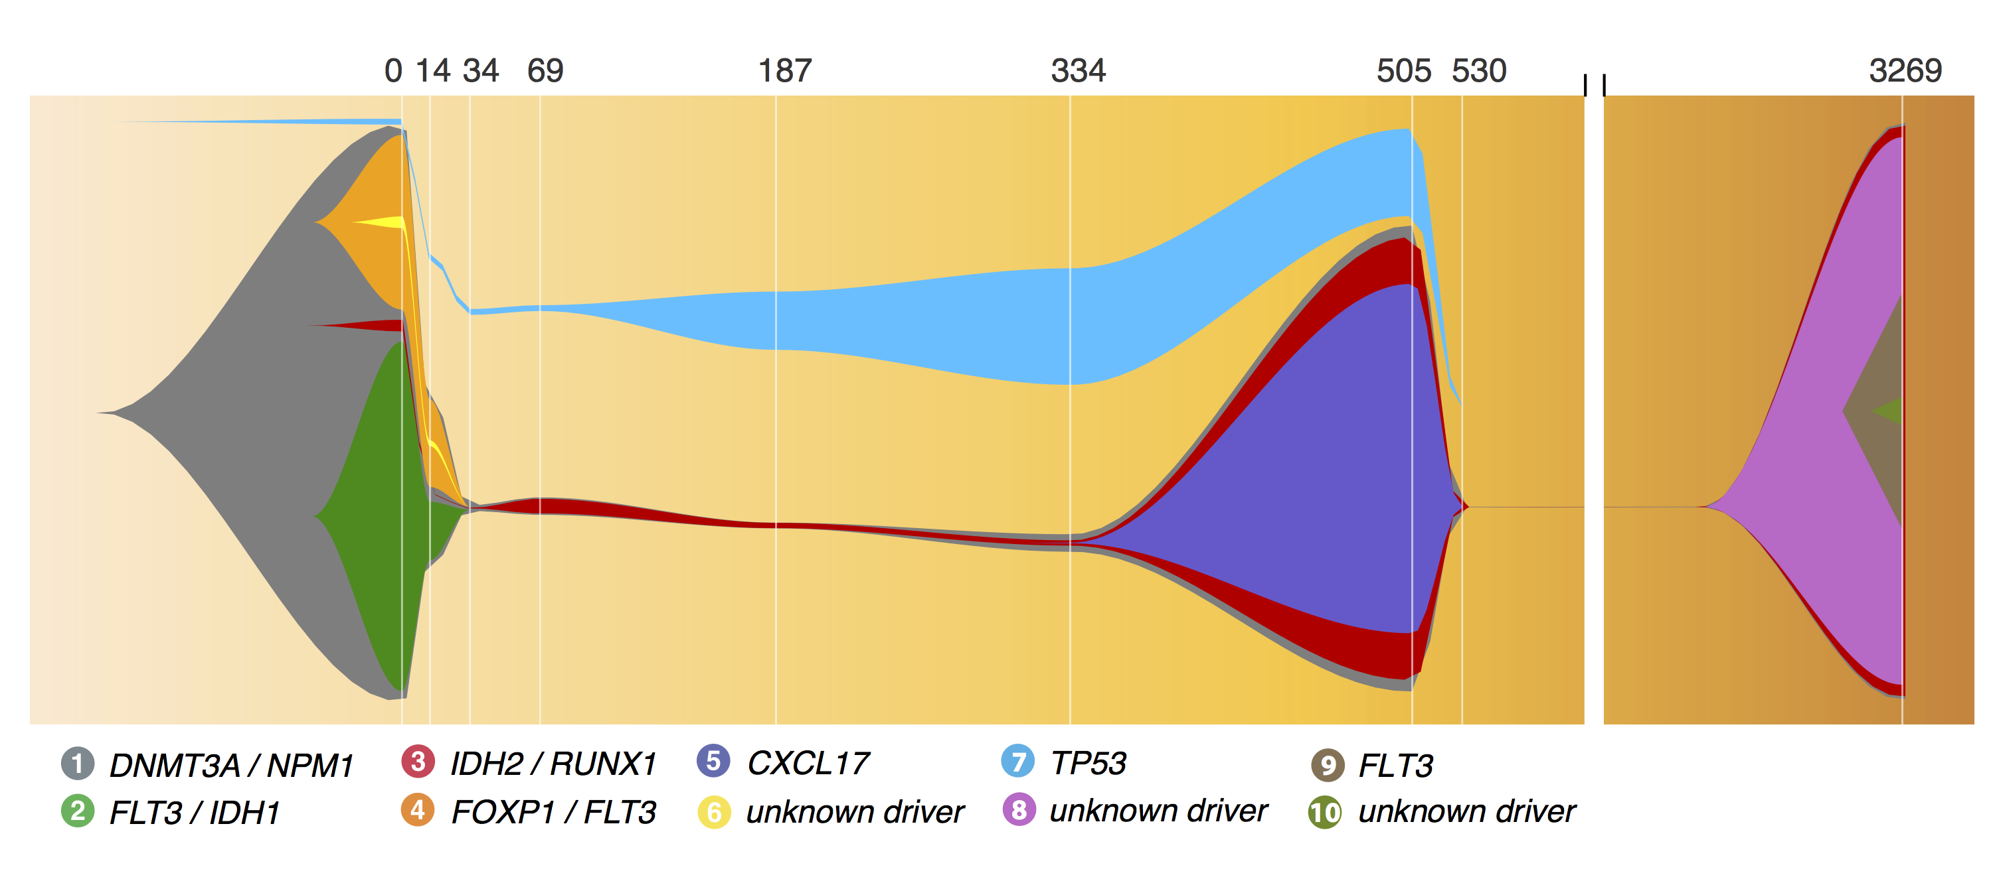
A ‘fish’ plot is used to represent sub-clones lost and gained over time

Slide 54
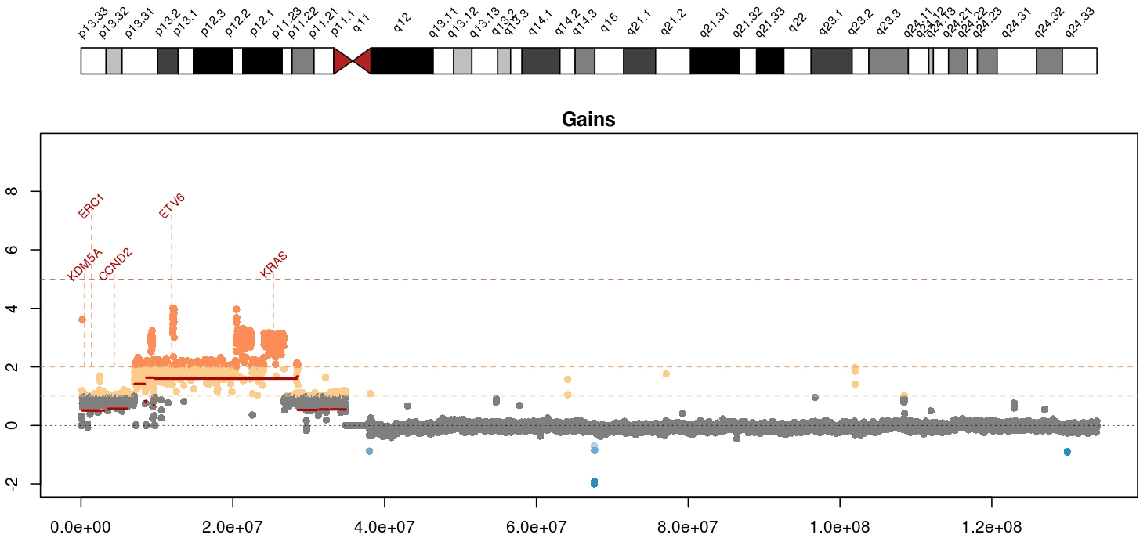
Visualizing copy number variation
Mean tumor-normal depth per 10kb window plotted
KRAS amplification in a metastatic breast cancer
Notes:
Whole genome data is exceptionally good a detecting copy number alterations in tumors. You essentially get a beautiful digital karyotype for each tumor. Here we see a complex amplification affecting KRAS and ETV6 and other critical cancer genes by both single copy and two copy gains.
We currently use cnv-hmm, CopyCat, and CnView for this kind of copy number analysis

Slide 55
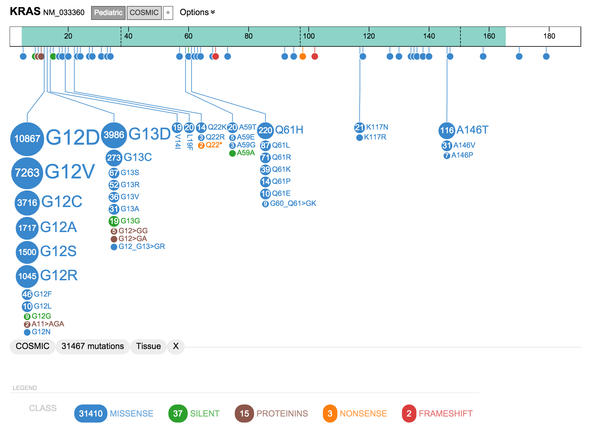
A ‘lollipop’ plot is used to variant recurrence in a gene
* Actually this one used “ProteinPaint” a web based tool

Slide 56
A ‘waterfall’ plot is one way to visualize the pattern of variant recurrence in a cohort of samples
https://github.com/griffithlab/GenVisR

Slide 57
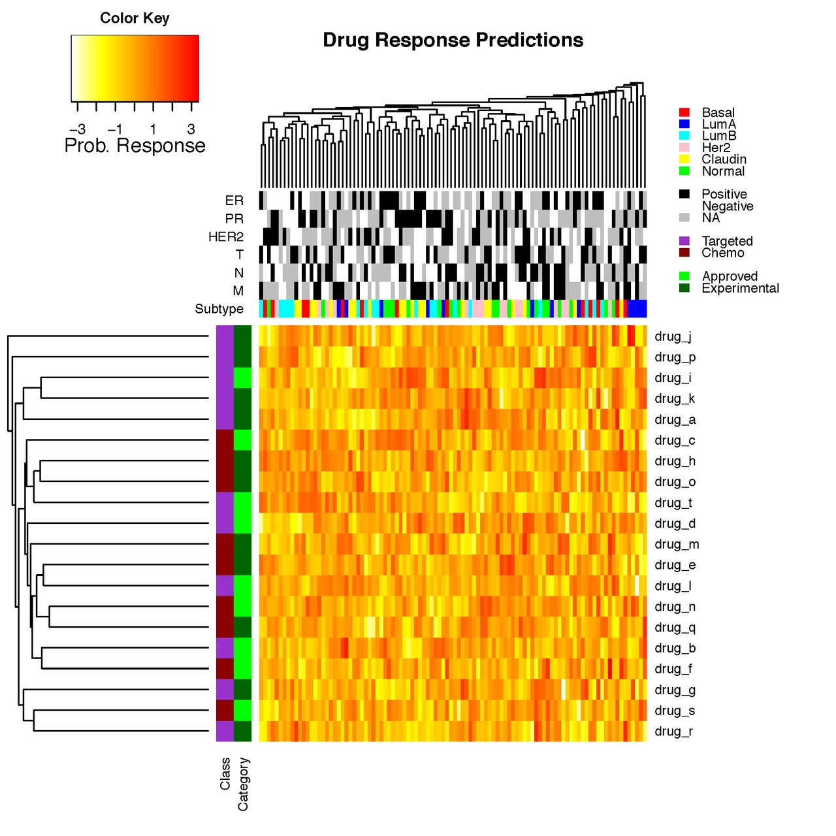
Heatmaps are a common way to simultaneously visualize multiple features of a dataset

Slide 58
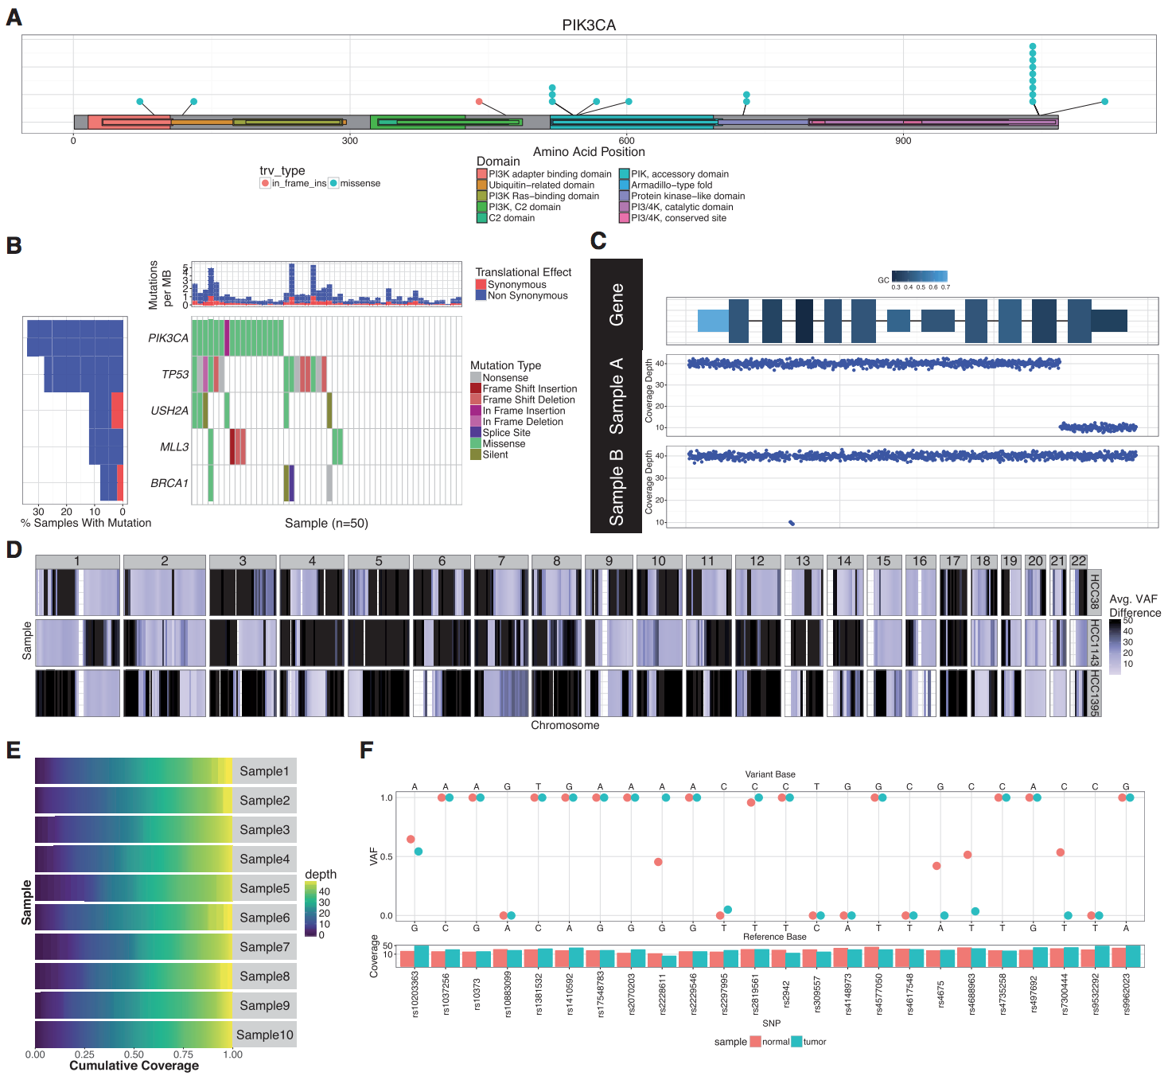
GenVisR was created to help others make common genomic visualizations

Slide 59
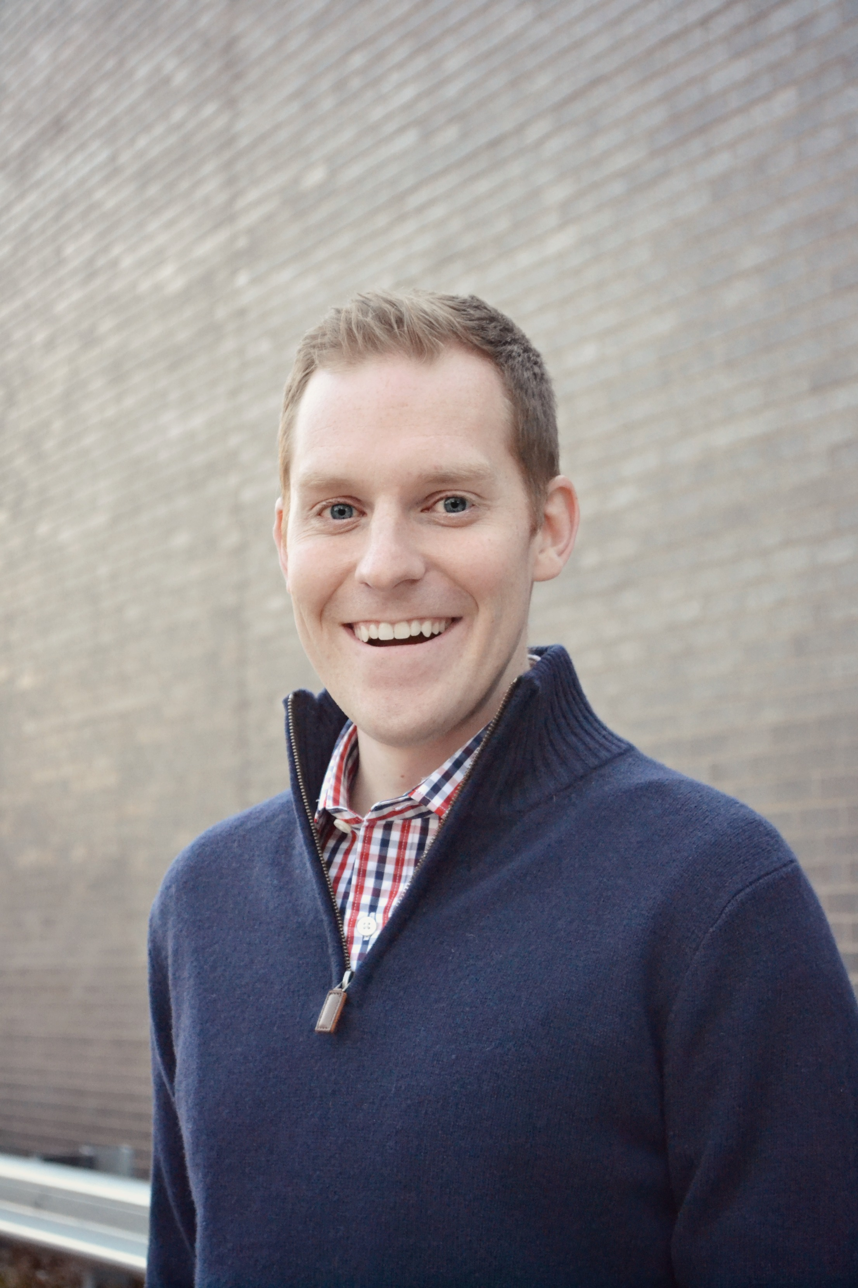
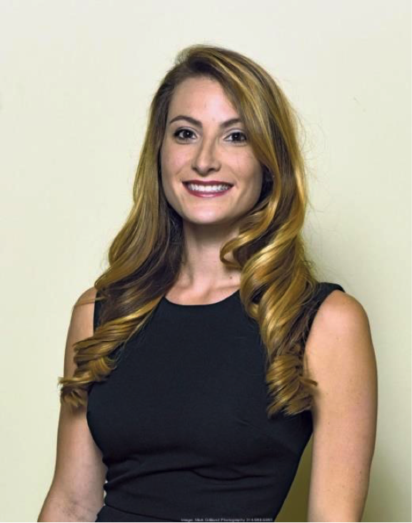
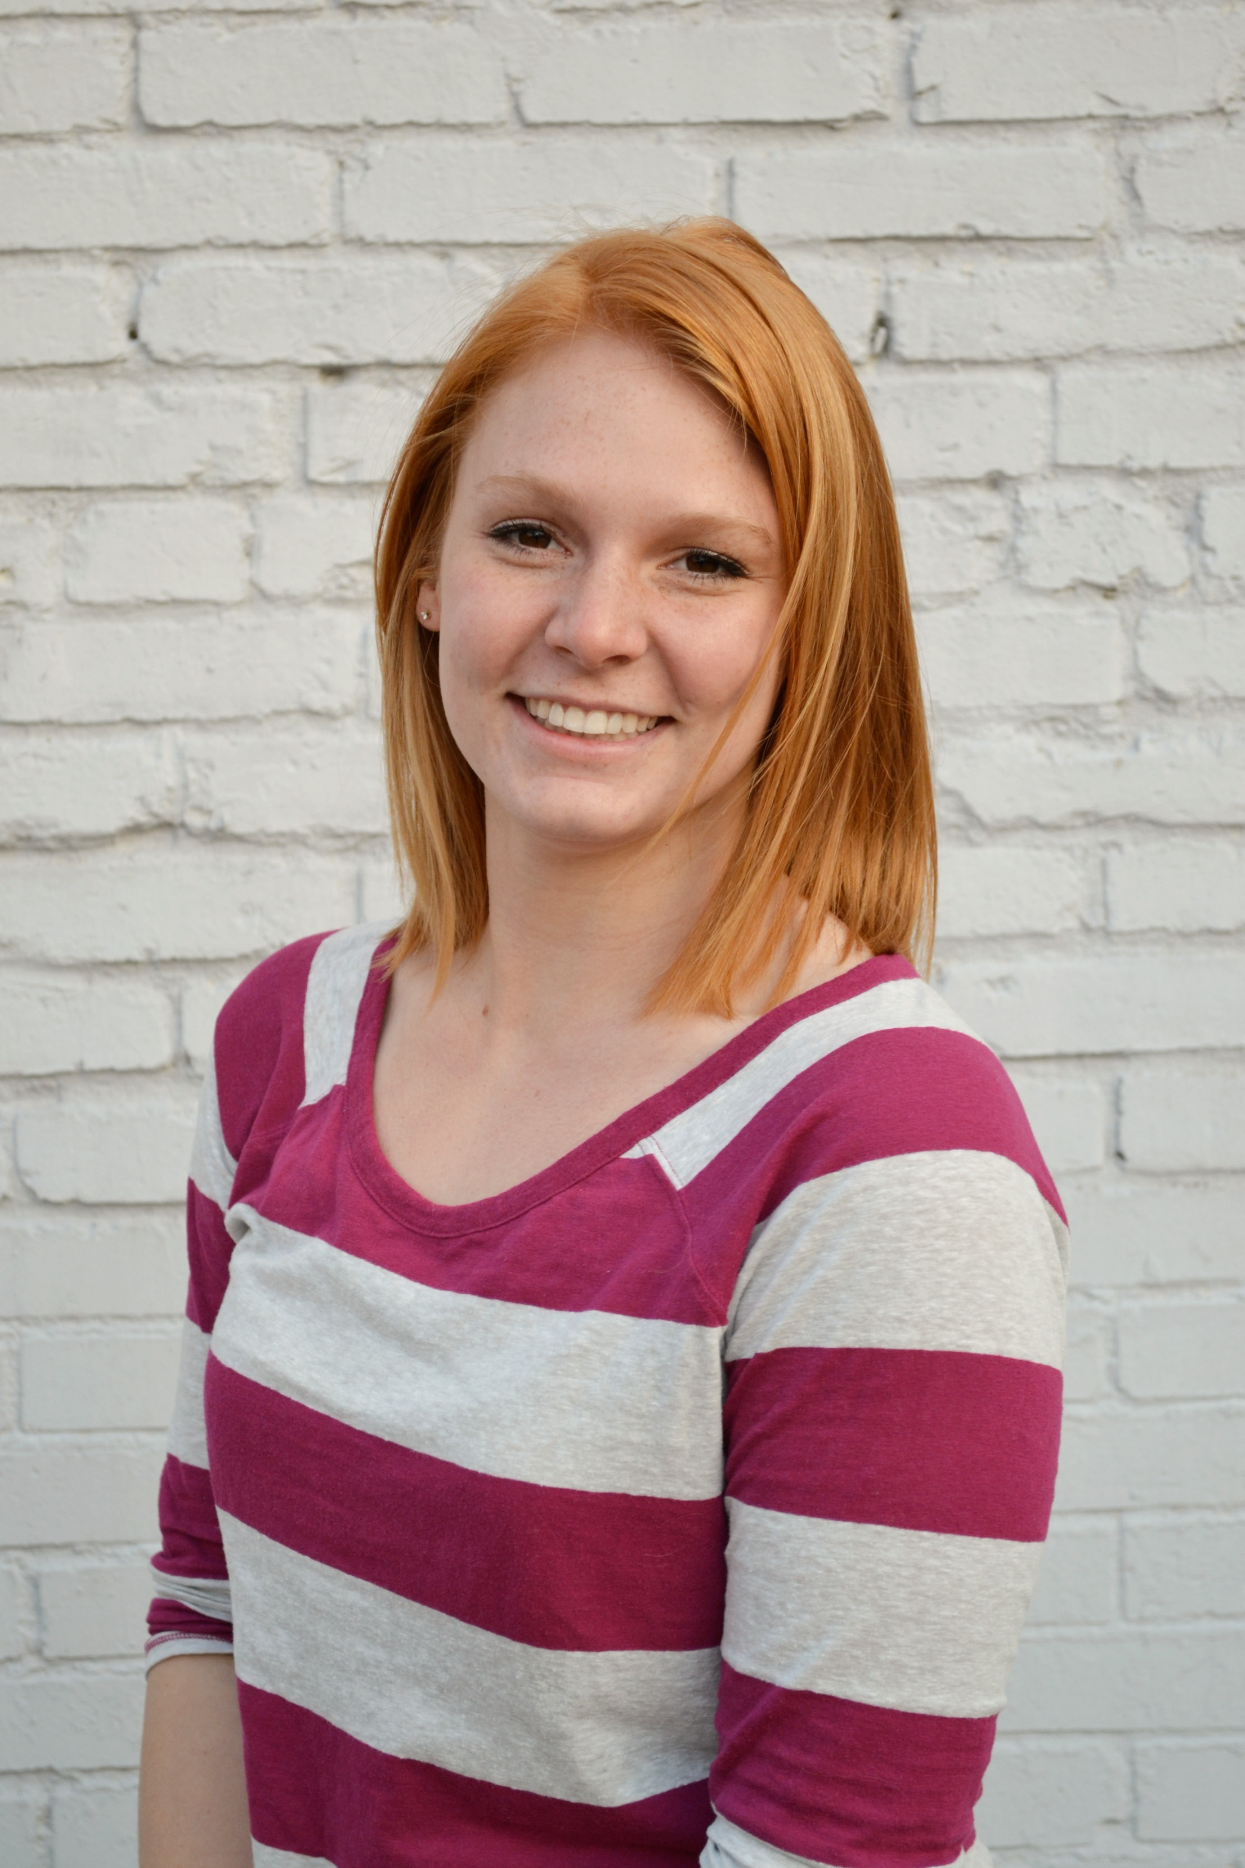
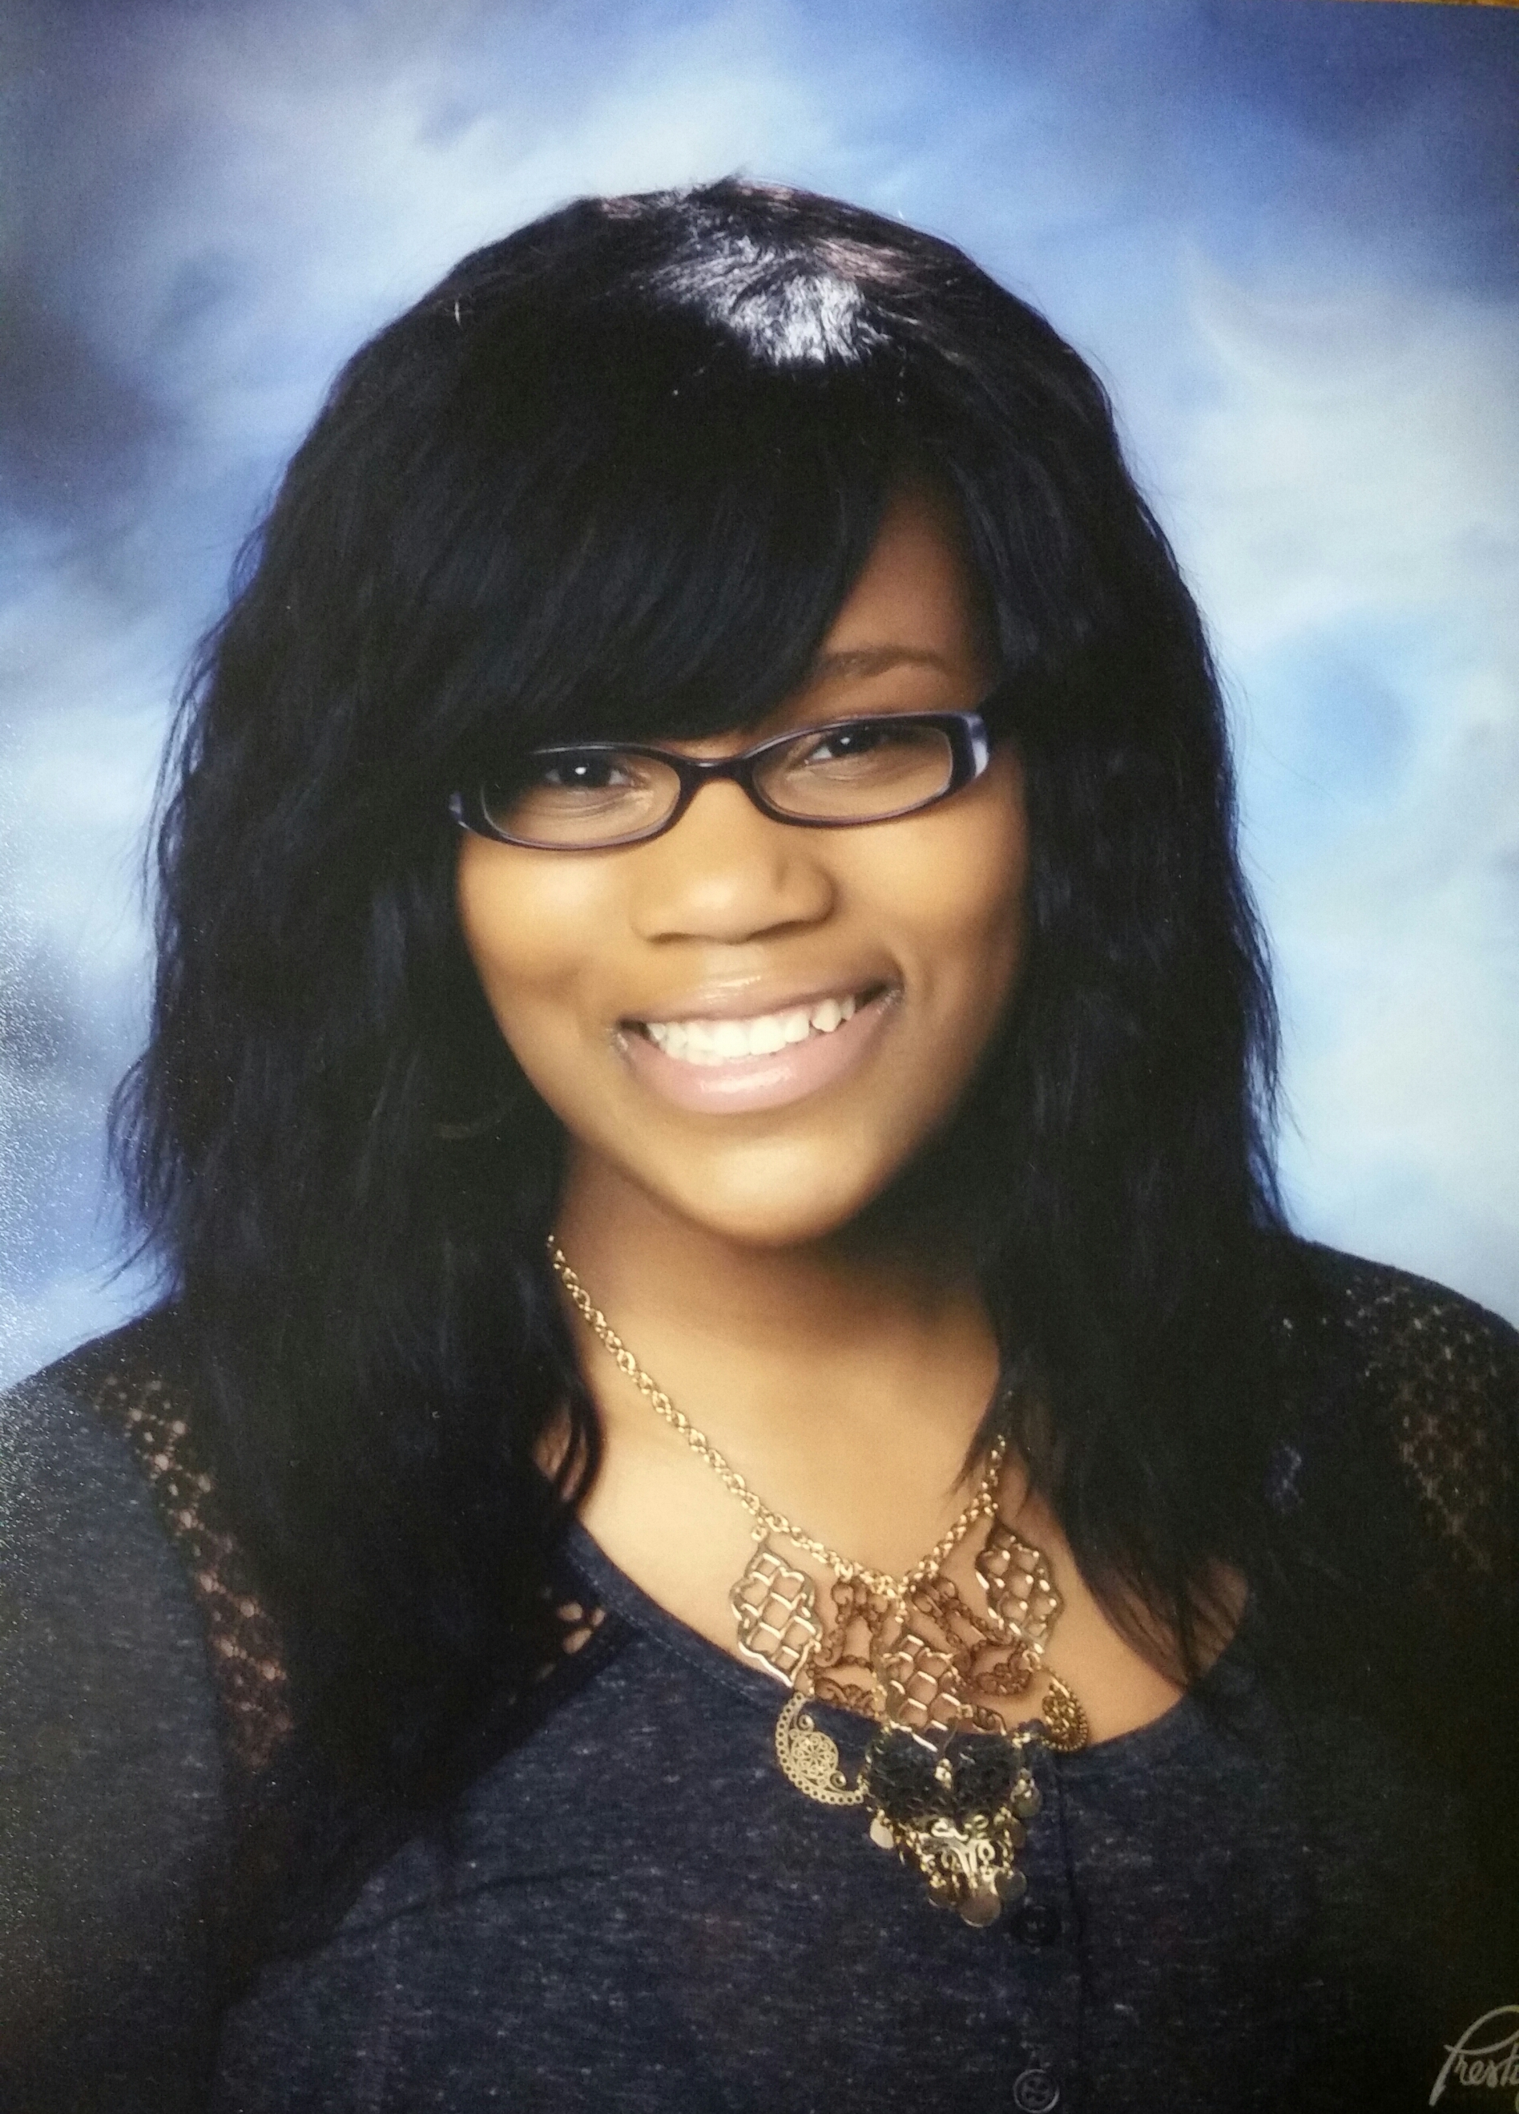
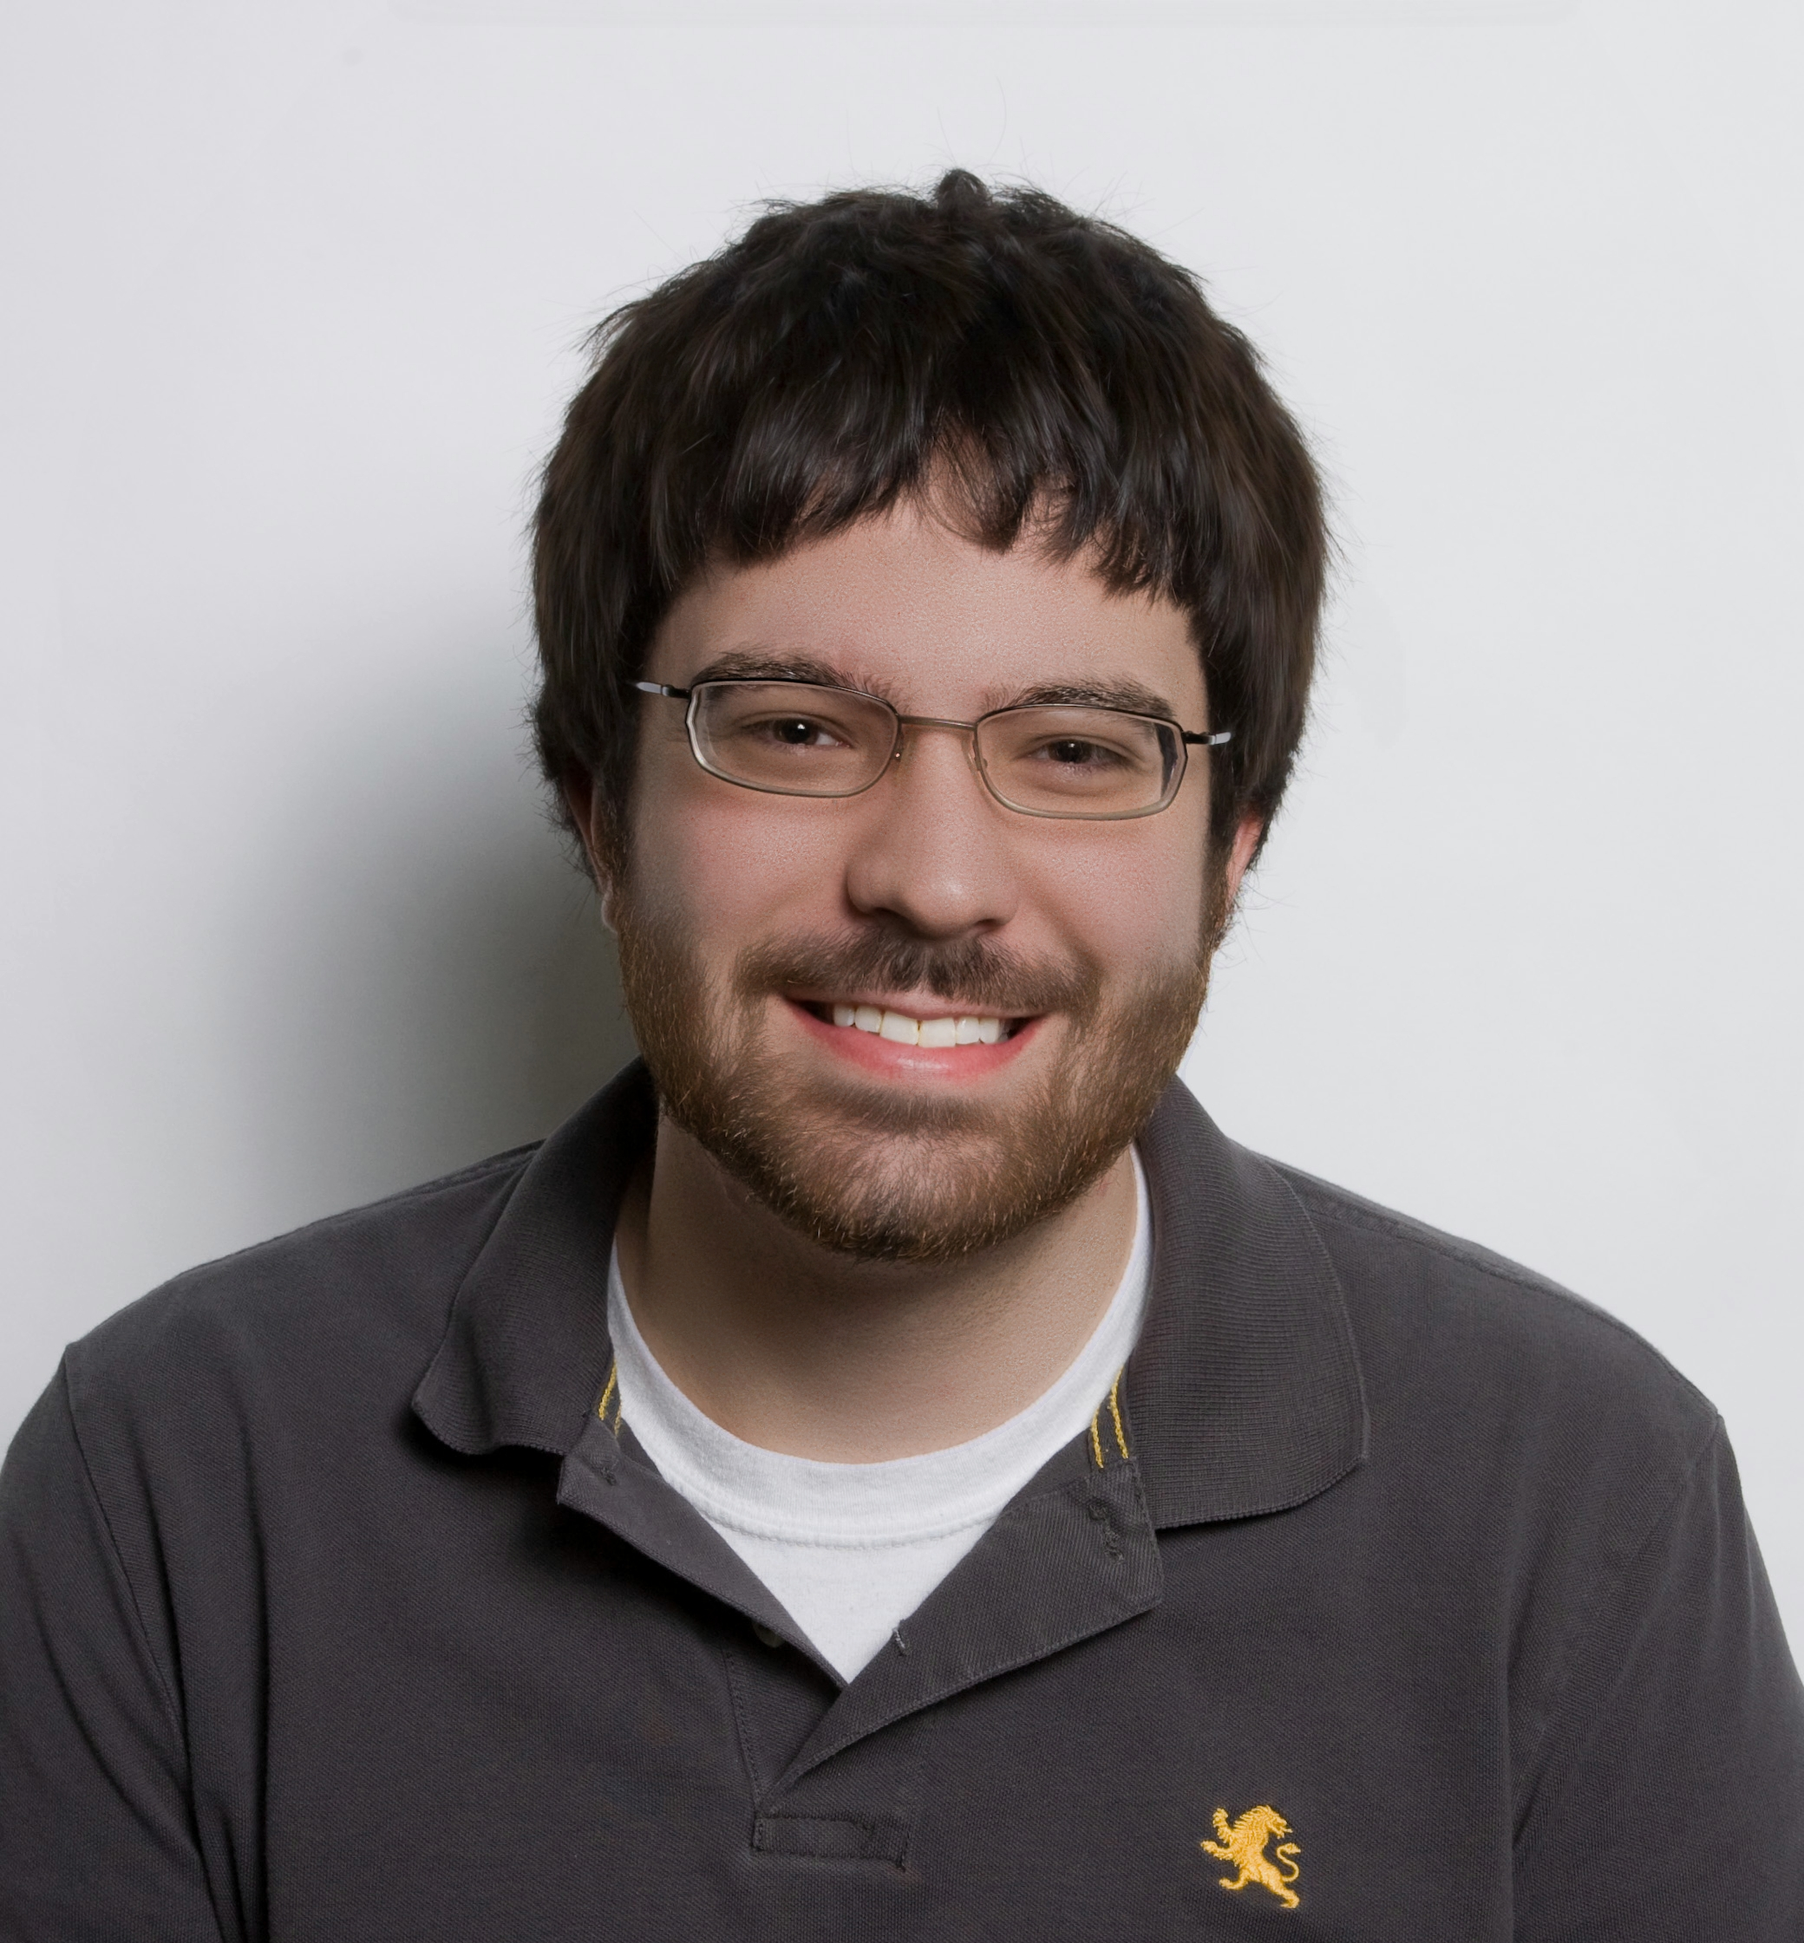
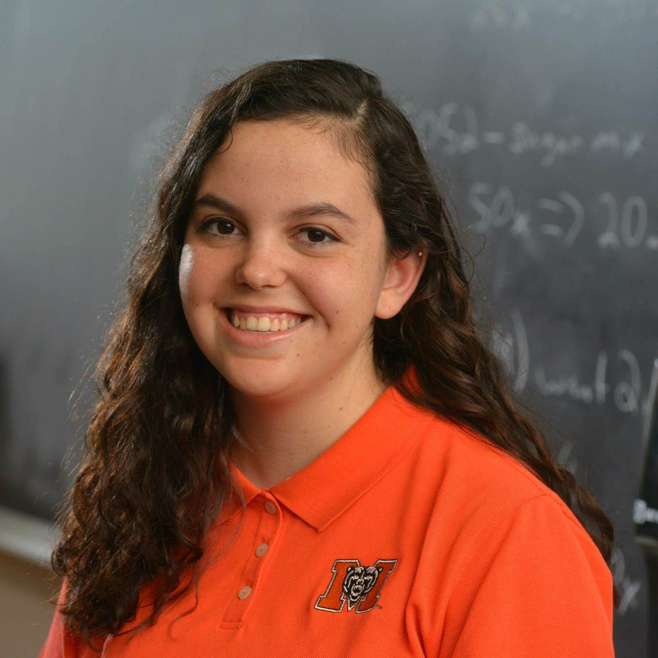
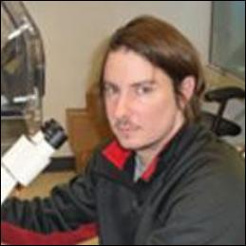
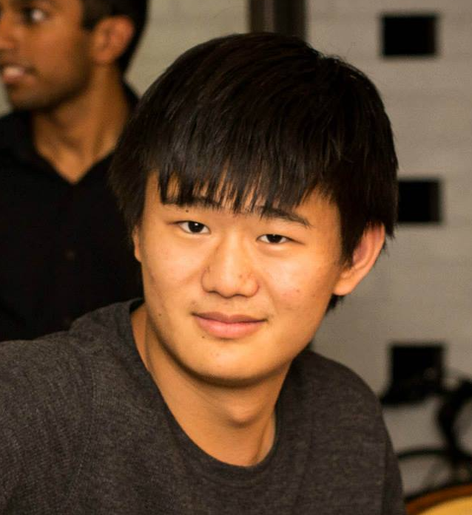
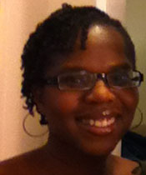
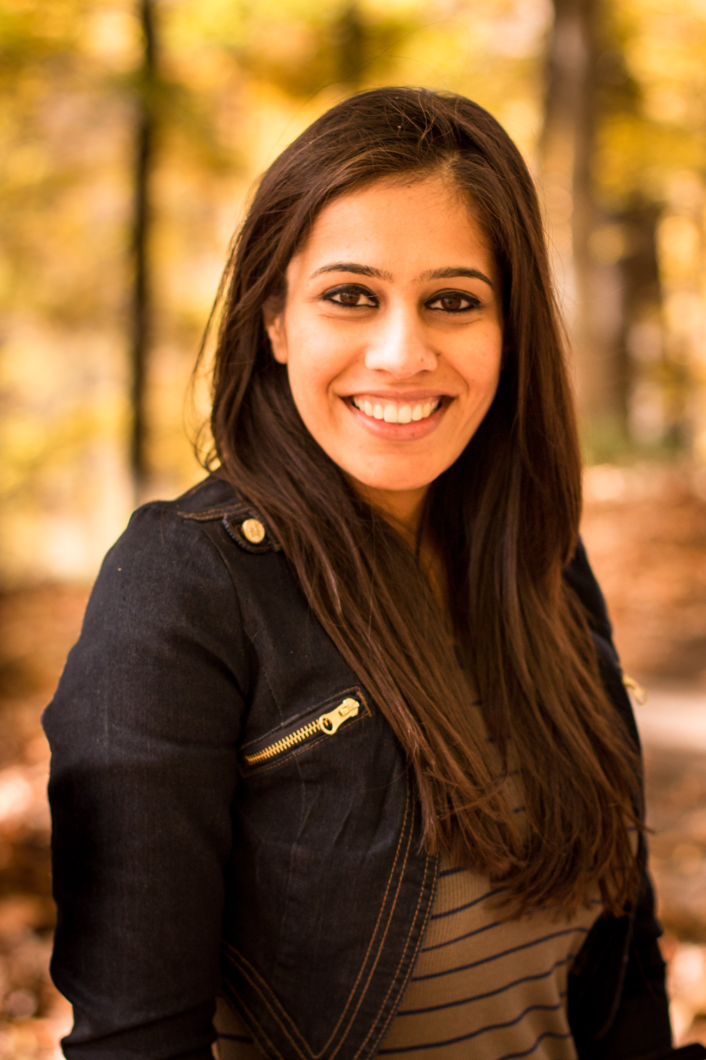
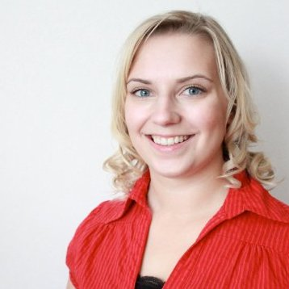
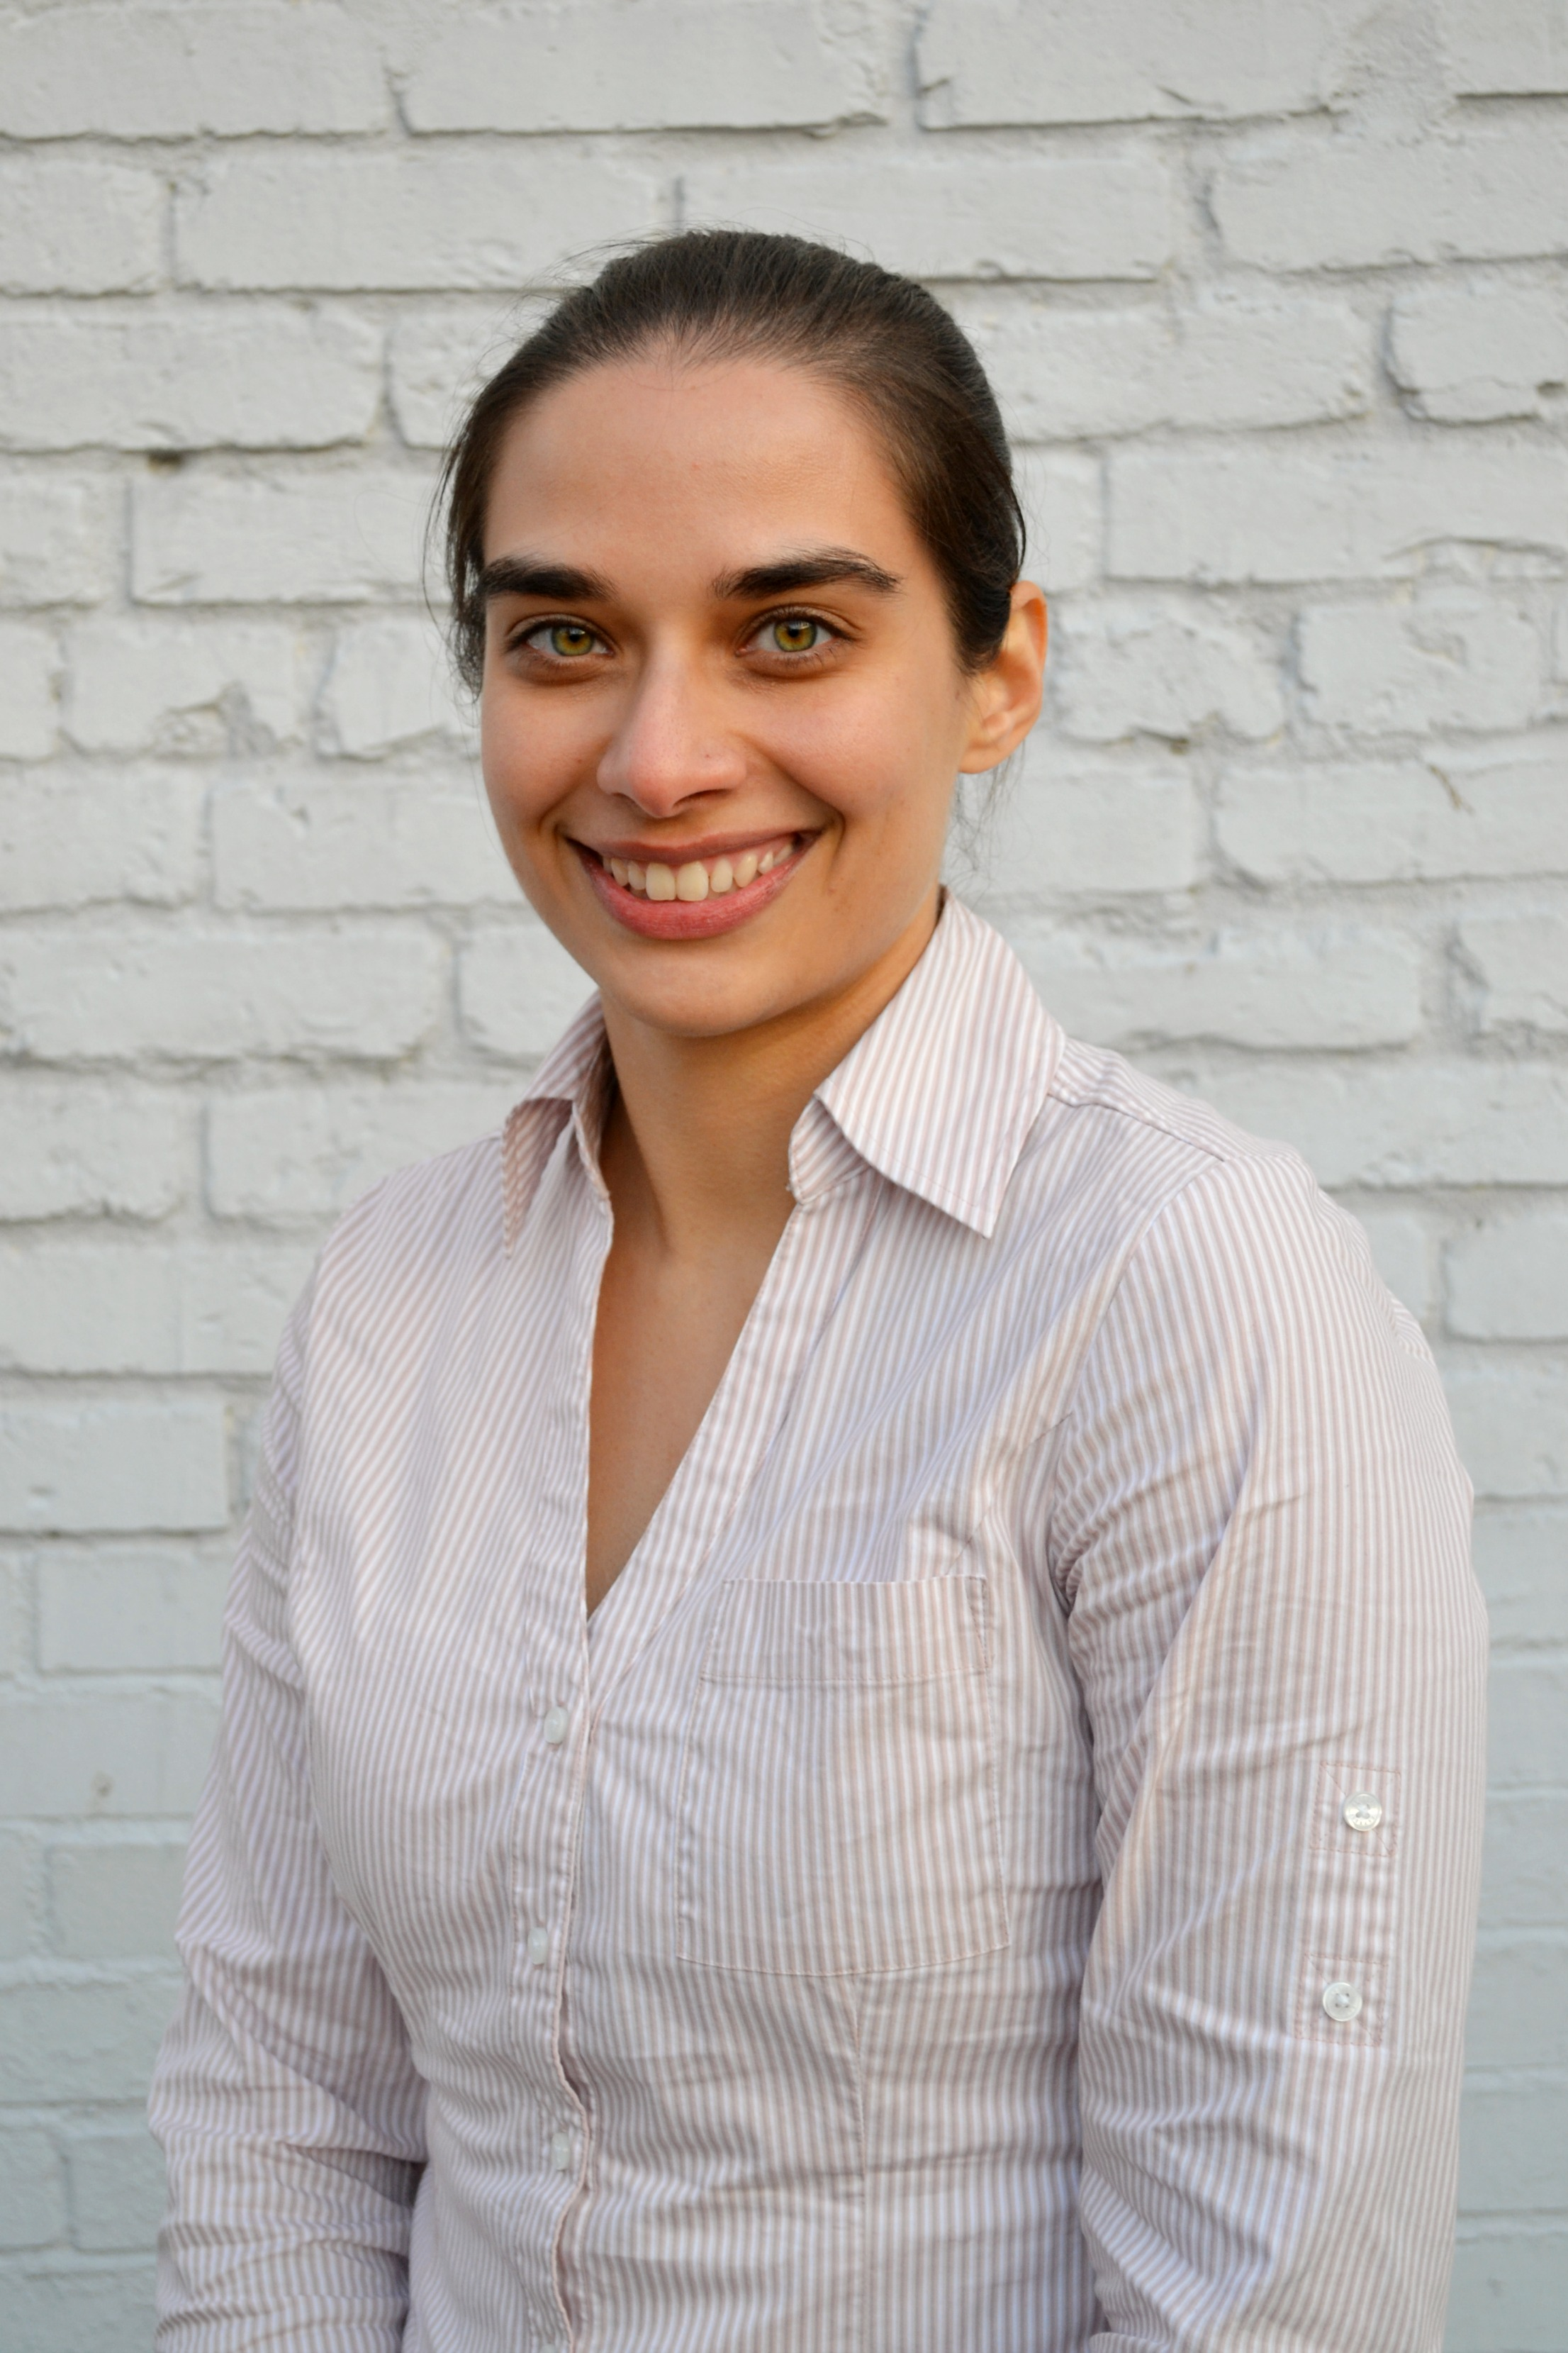









Acknowledgements: Griffith Lab group members
DoCM
CIViC
CIViC OSCC
OSCC
CIViC
CIViC/DGIdb
DGIdb/Regulome
Malachi
Griffith
Obi
Griffith
Benjamin
Ainscough
Erica Barnell
Katie
Campbell
Kaitlin Clark
Adam
Coffman
Kelsy Cotto
CIViC/Regulome
Regtools/pVAC-seq
pVAC-seq
pVAC-seq/CIViC
CIViC/Lymphoma
CIViC
HCC
Lymphoma
Arpad Danos
Yang-Yang Feng
Felicia Gomez
Jasreet
Hundal
Susanna Kiwala
Kilanin
Krysiak
Lynzey Kujan
Jason Kunisaki
CIViC
CIViC Lymphoma
genVisR
HCC/SCLC
CIViC/Komen
HCC/SCLC
DGIdb
SCLC
Director Informatics
Josh
McMichael
Cody Ramirez
Zachary
Skidmore
Nick
Spies
Lee
Trani
Alex
Wagner
Jason Walker
Notes:
Not shown: Lynzey Kujan (Intern), Susanna Kiwala,

Slide 60

Acknowledgements: McDonnell Genome Institute
McDonnell Genome Institute @ Washington University School of Medicine
Susan Dutcher
Tim Ley
Bob Fulton
Lucinda Fulton
Ira Hall
Dave Larson
Chris Maher
Lukas Wartman
Matt Callaway
Chris Miller
Jason Walker

Slide 61
Introduction to GenViz course site
www.genviz.org

